Slide 1

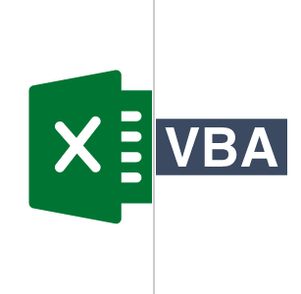
Excel and VBA Programming
Mini Project

Slide 2
Submitted by
Mohammad Monjur-E-Elahi
Course: Microsoft Excel and VBA Programming [DSA02]
Program: Data Science and Application - Advanced Diploma [6060]
Metro College of Technology
Date: 19 Aug, 2021

Slide 3
Phase 01
THANKS
1. For online retail data set create a bar chart from that data in excel file.
CONCLU
2. For online retail data set create a pivot table and group data.
3. Create a button and assign a macro to it that displays in message the current date.
4. Create a procedure that declares variables of type string and integer
Phase 02
1. Create a VBA procedure that changes the font color of table to bold.
2. Create a VBA procedure that adds a yellow explanation column to right of table.
3. Create a VBA procedure that uses loop.
4. Create a message box that displays number of executions of one procedure.
5. Create a user Form that has two text boxes and a button to calculate sum and show it in a message box.
6. Create a User Form in Excel VBA to get name, date of birth, gender, telephone number, email, and postal code from the user and store the value provided by the user in the worksheet.

Slide 4
Creating a bar chart from the data for online retail data set in excel file
LIST

Slide 5
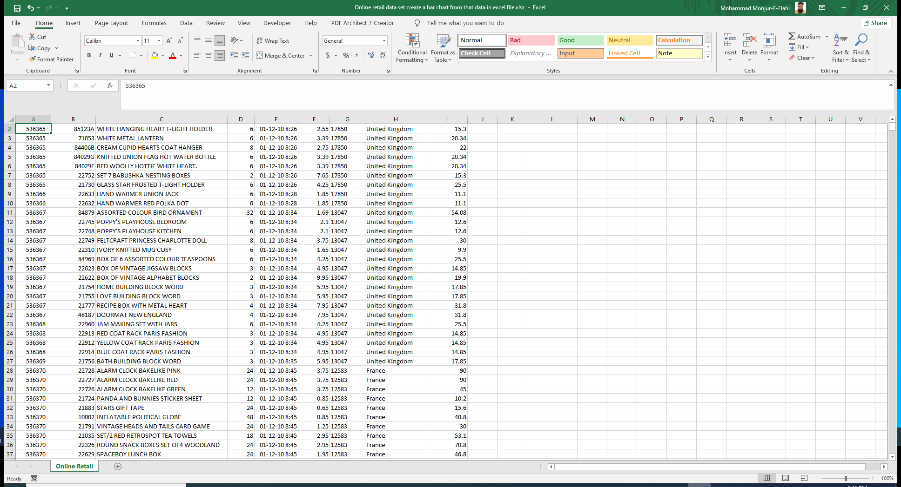

Slide 6
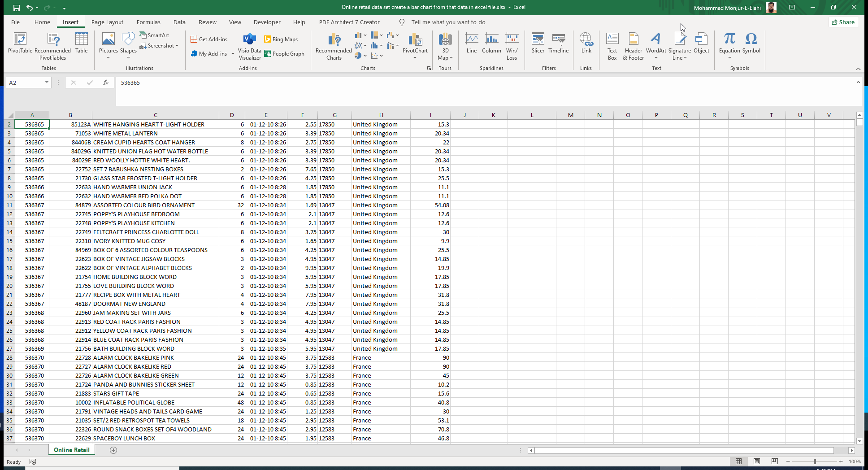

Slide 7
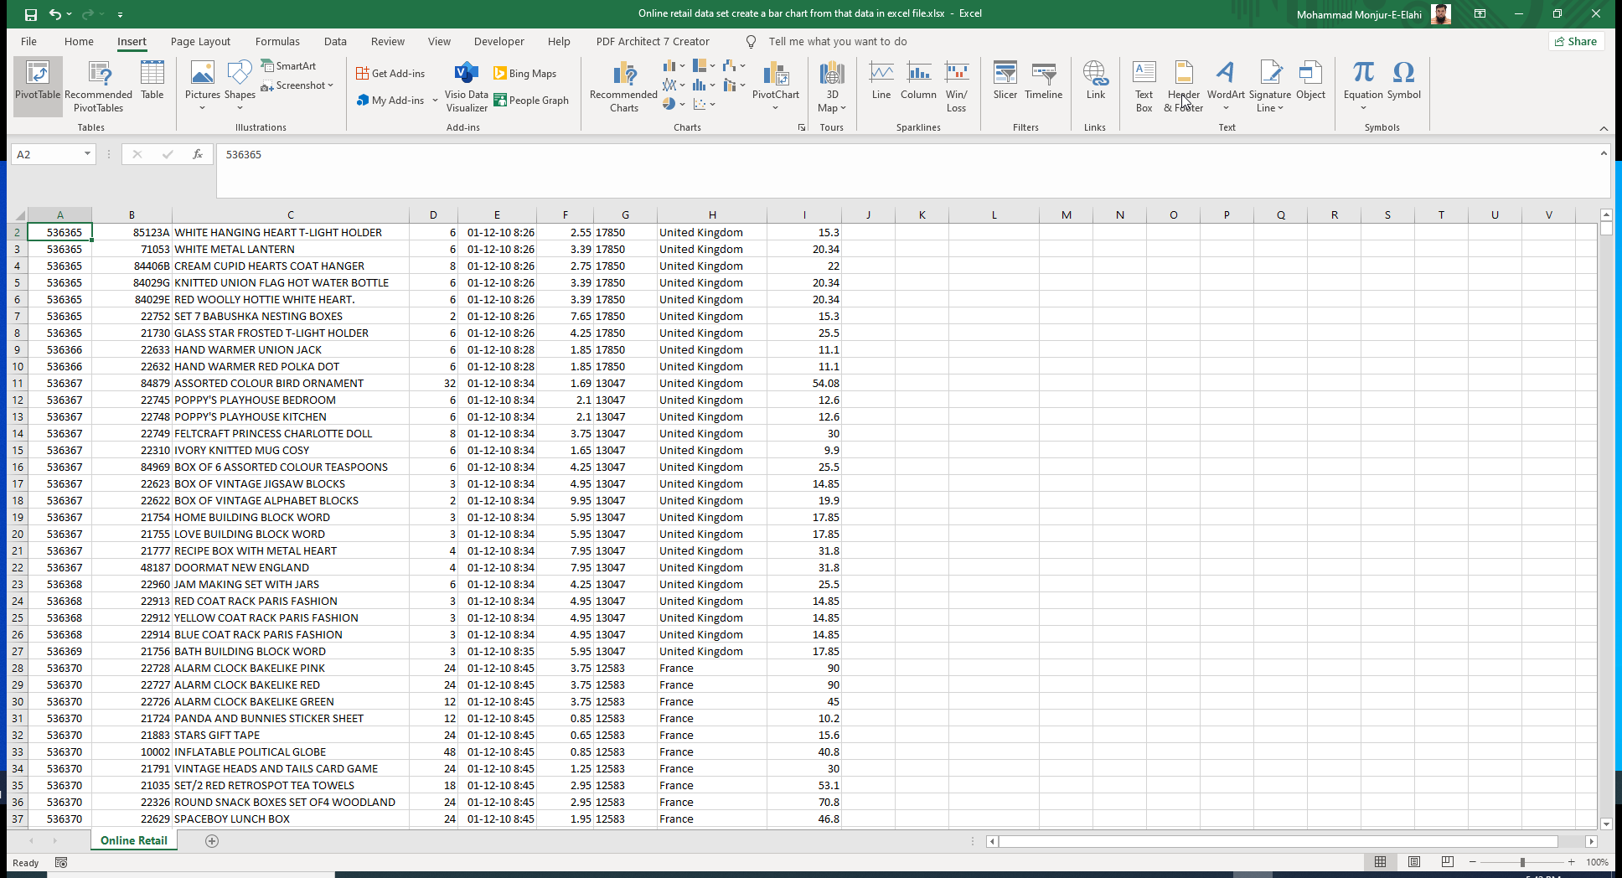

Slide 8
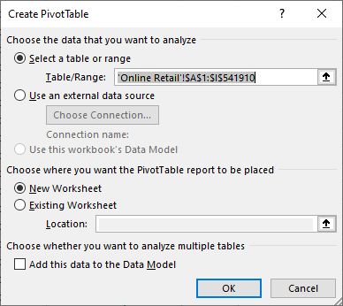
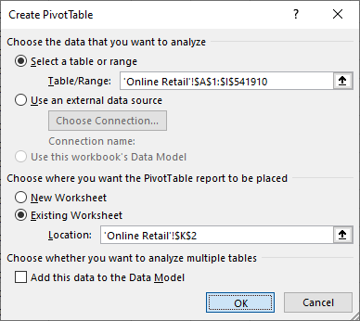

Slide 9
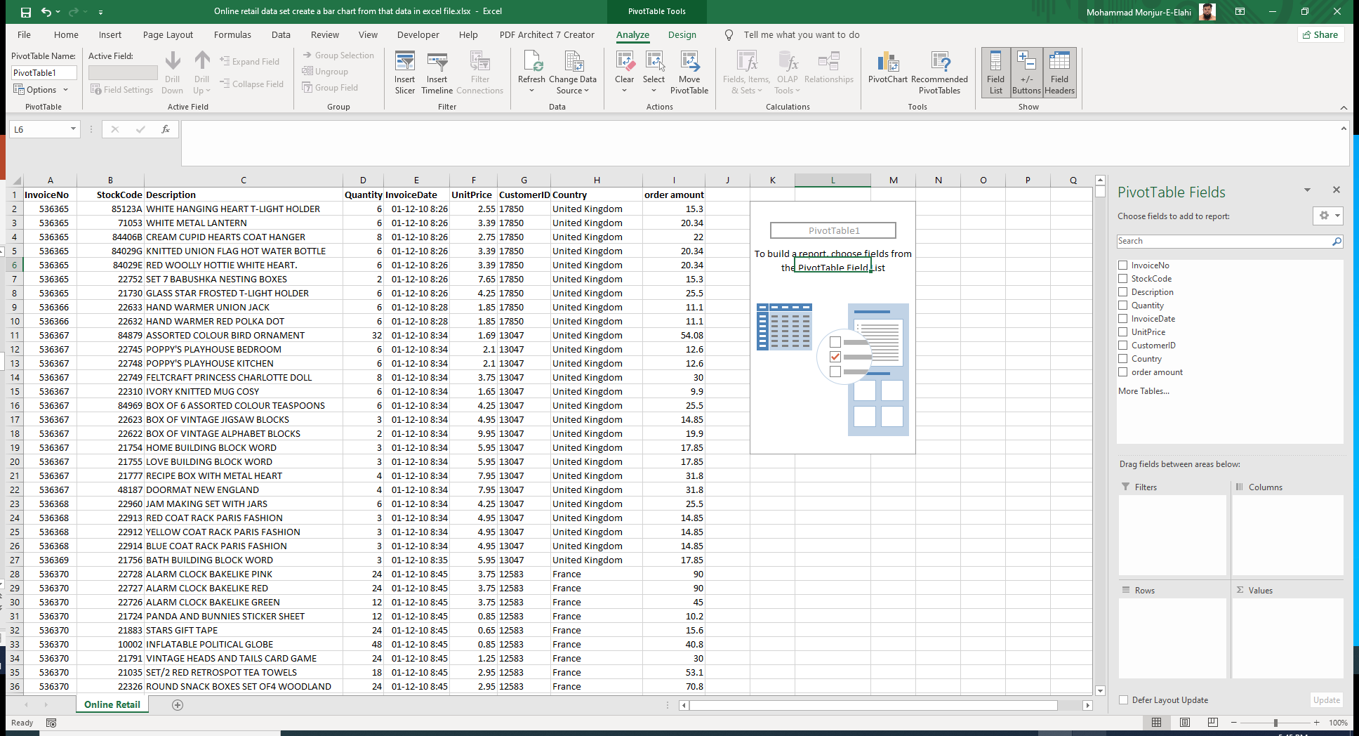

Slide 10
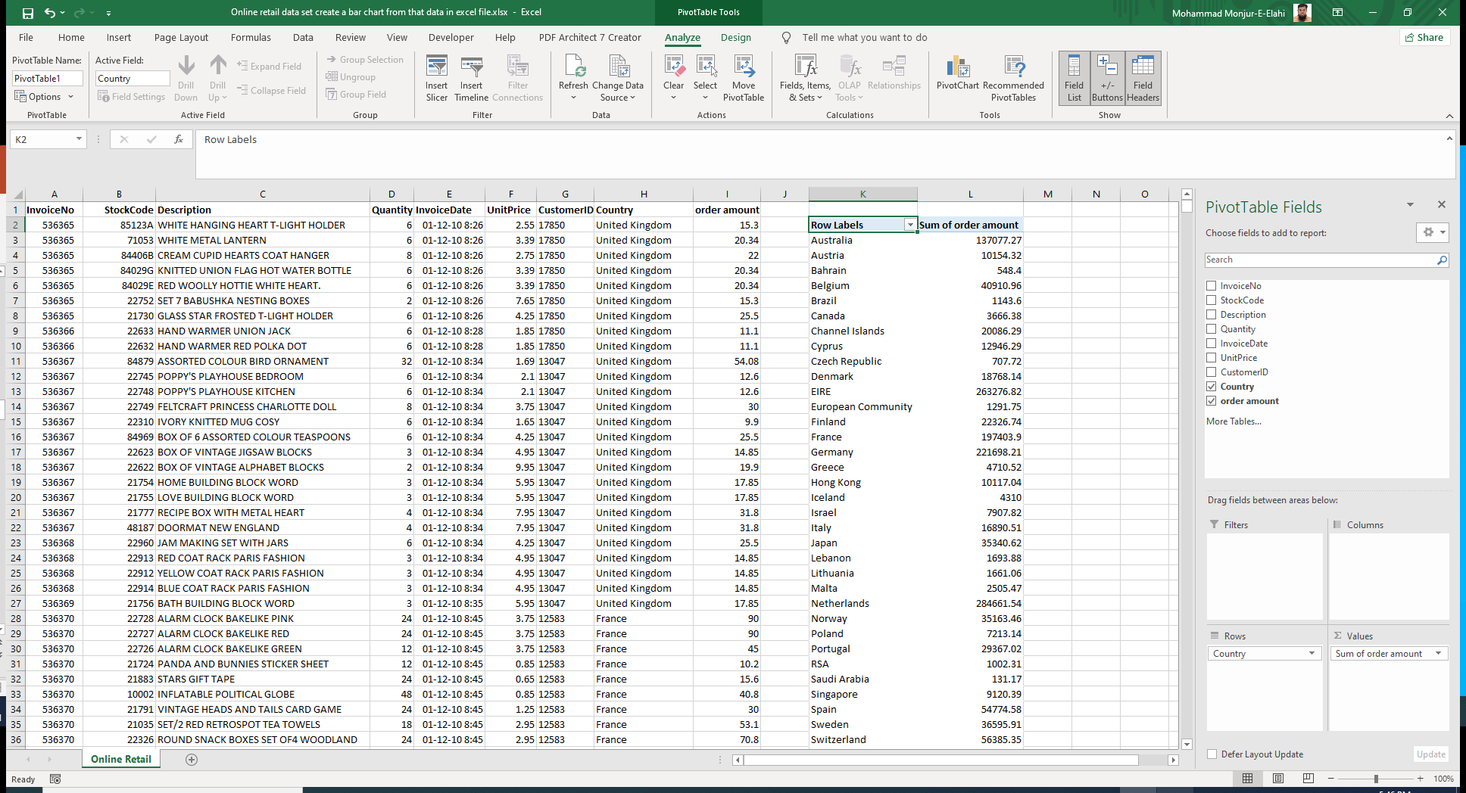

Slide 11
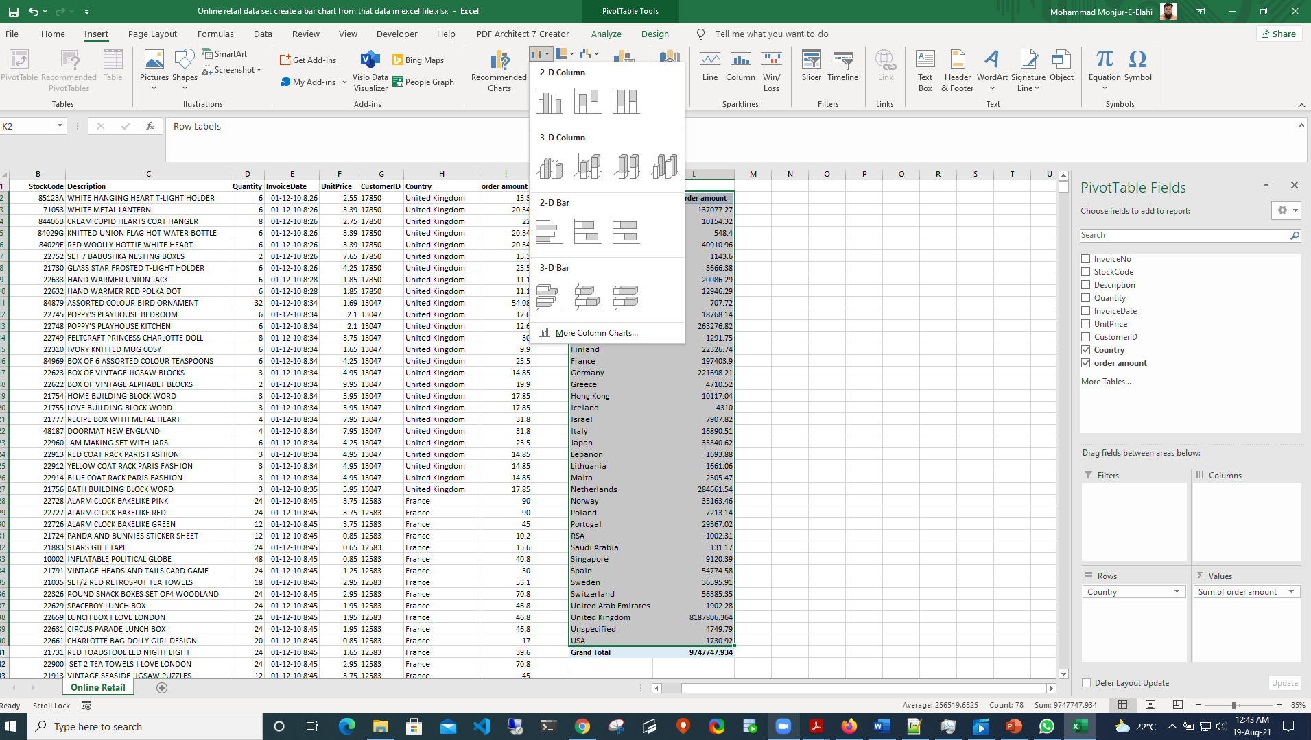

Slide 12
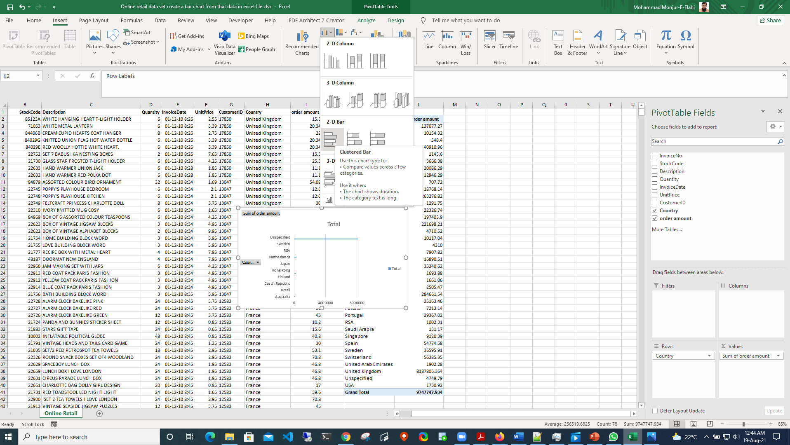

Slide 13
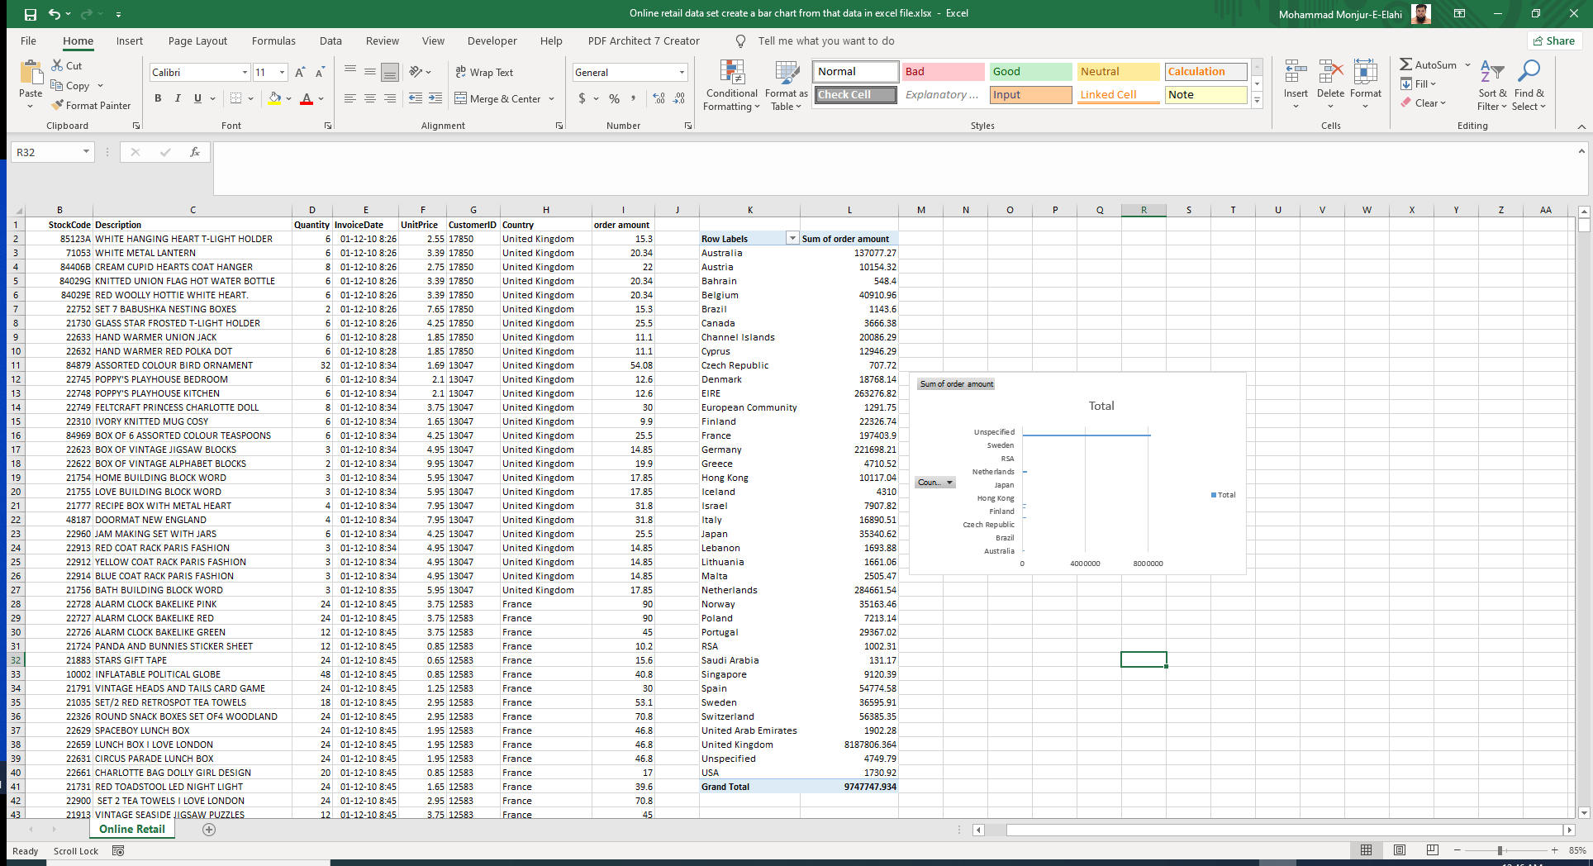

Slide 14
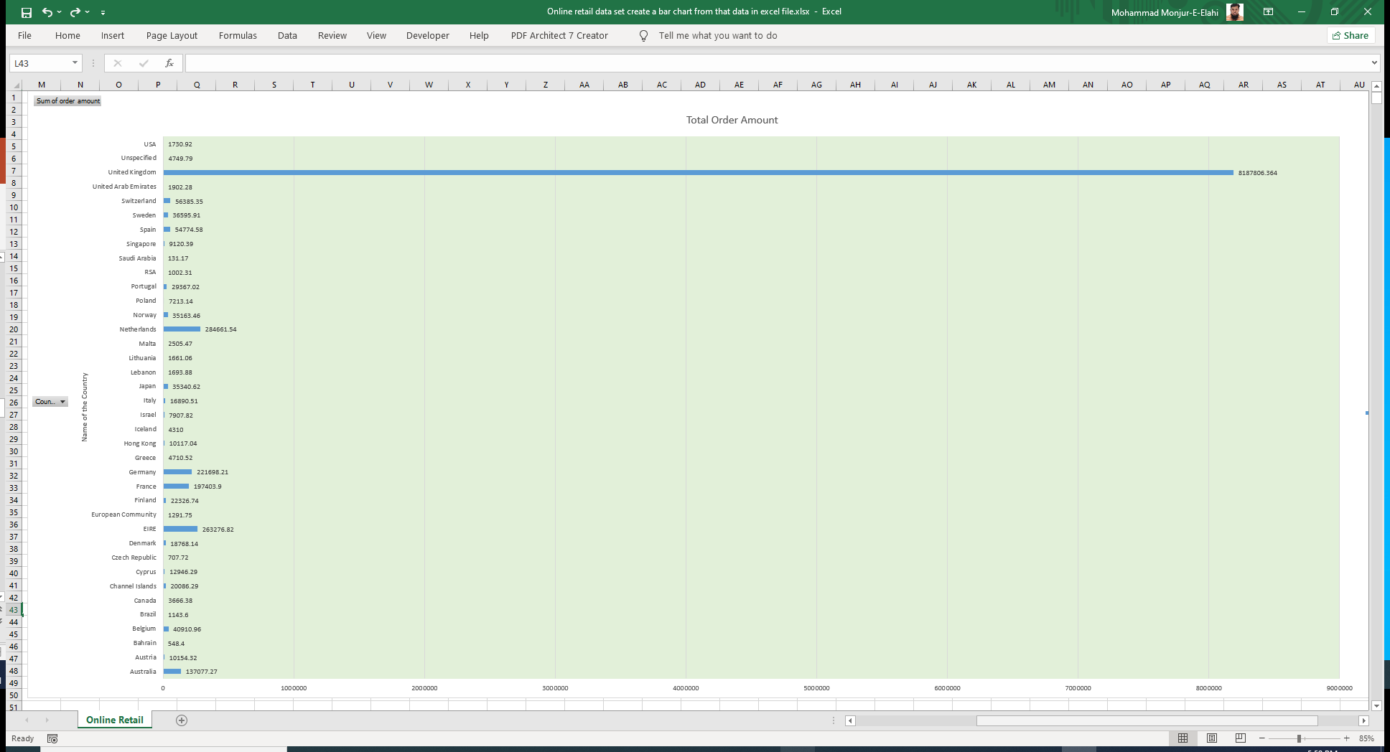
LIST

Slide 15
Creating a pivot table and grouping data from the data for online retail data set
LIST

Slide 16
I wanted to group by countries and get order sum for top 10 countries for the month of Dec, 2011

Slide 18
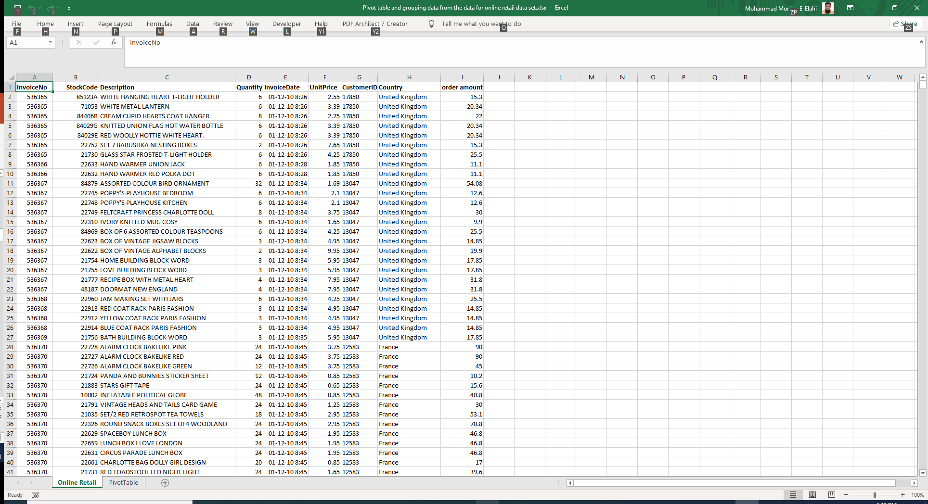

Slide 20
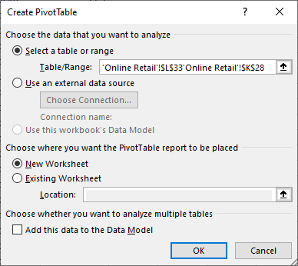
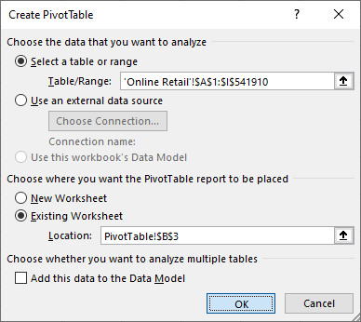

Slide 21
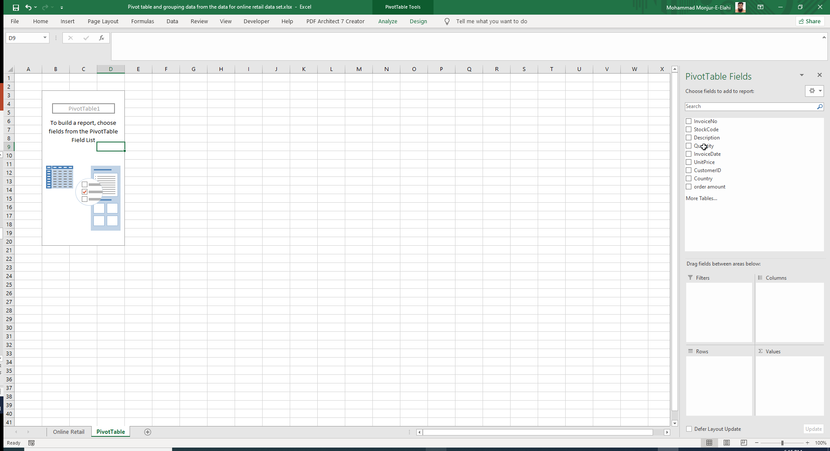

Slide 22
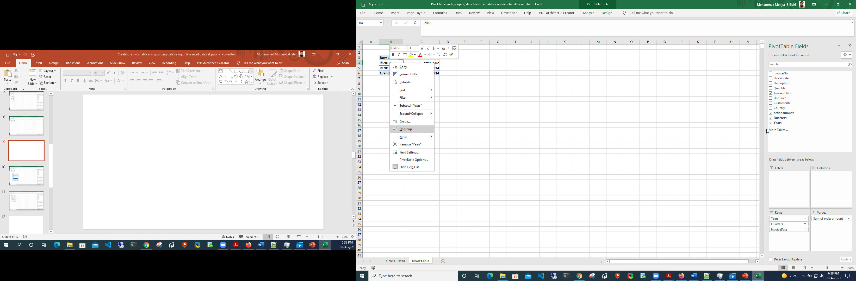
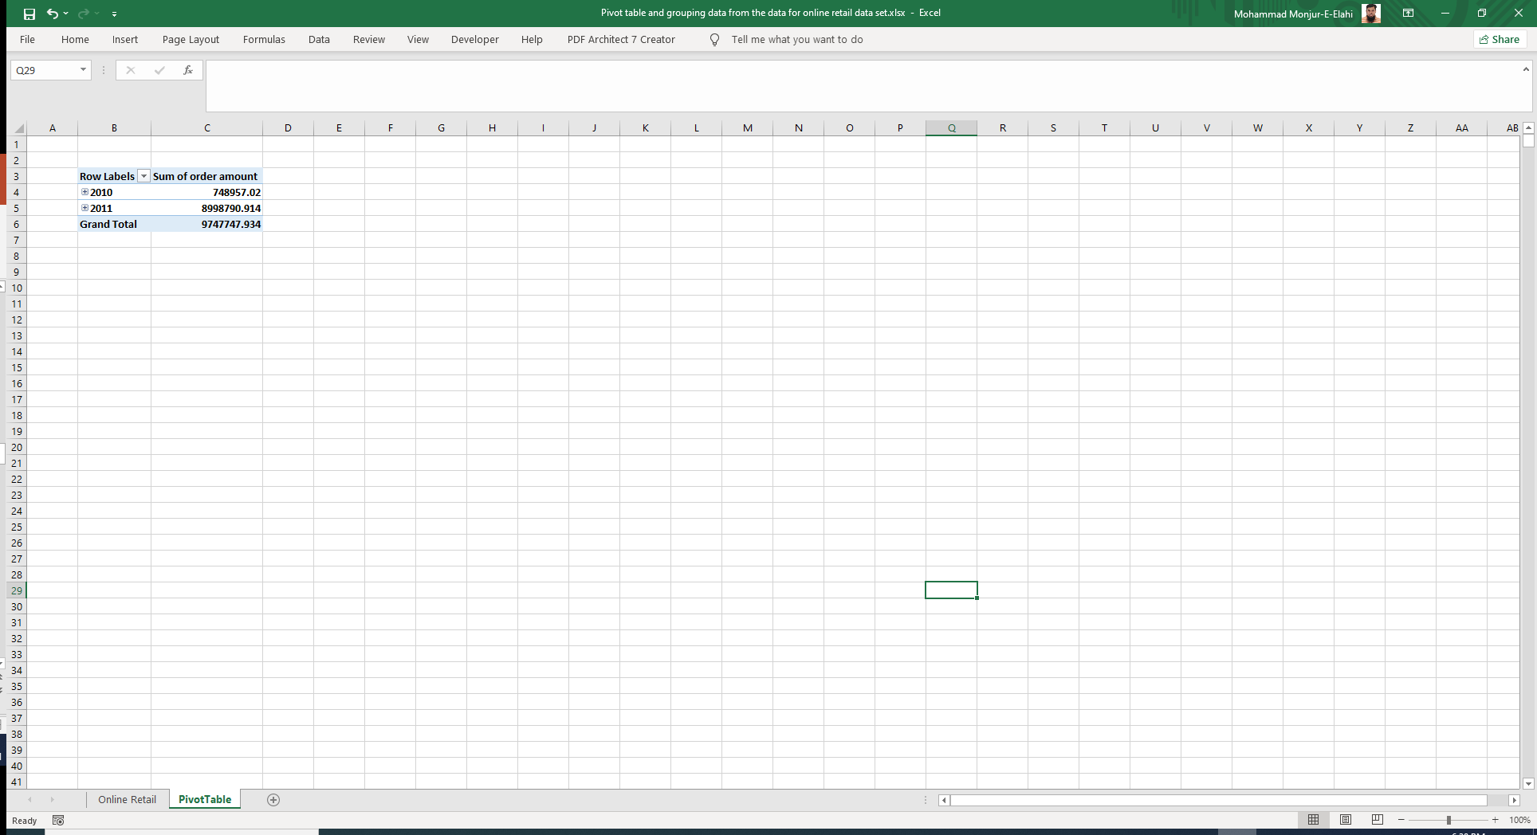

Slide 24
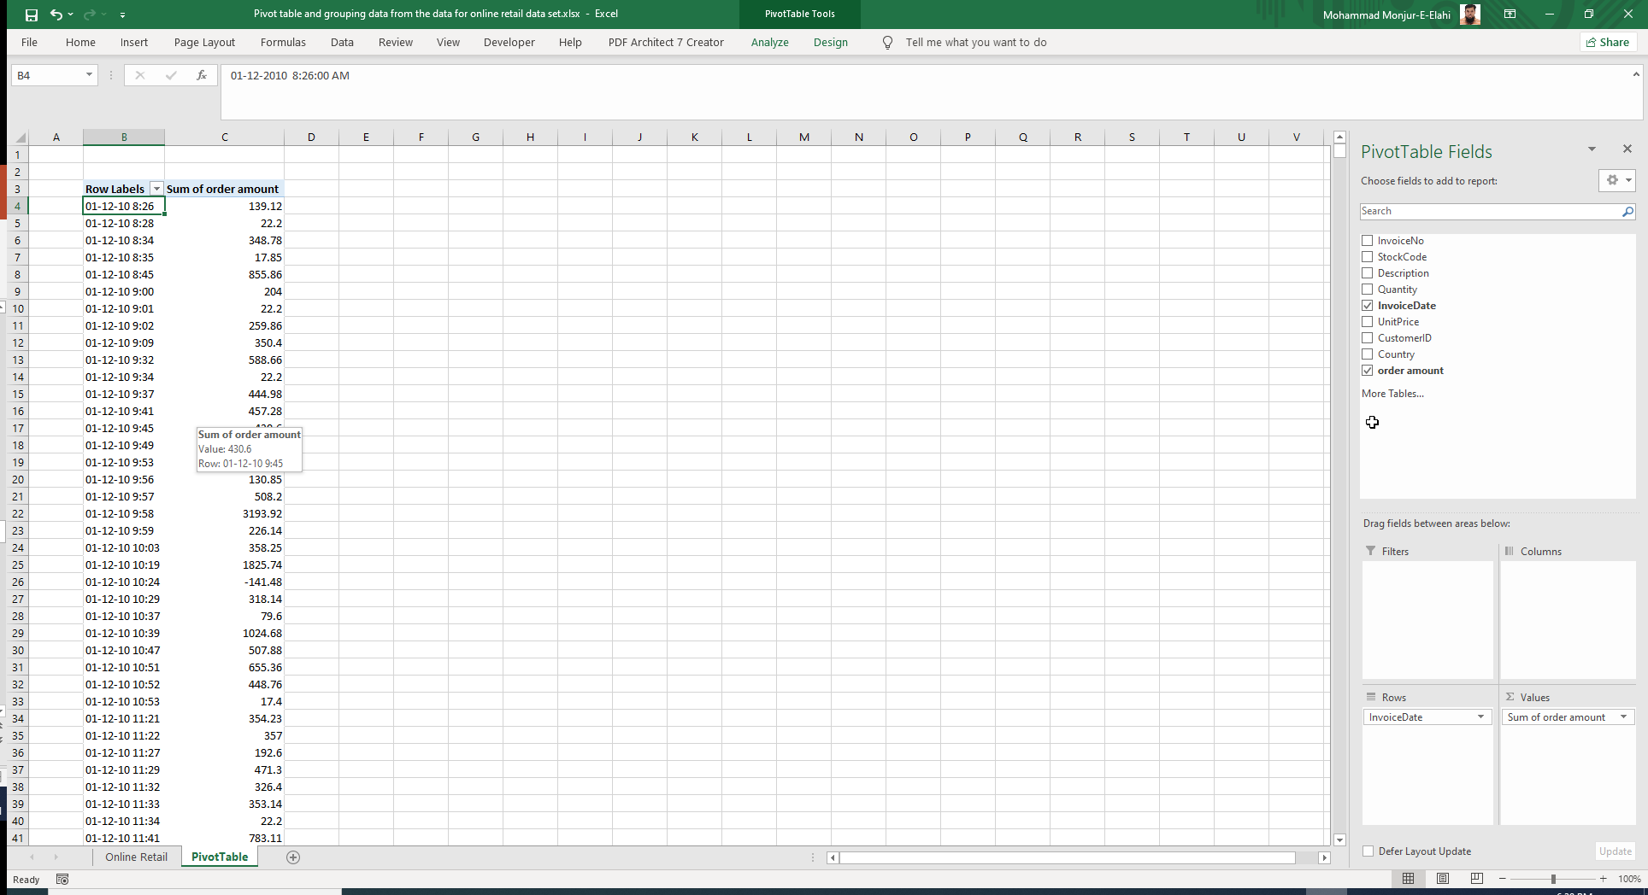

Slide 25
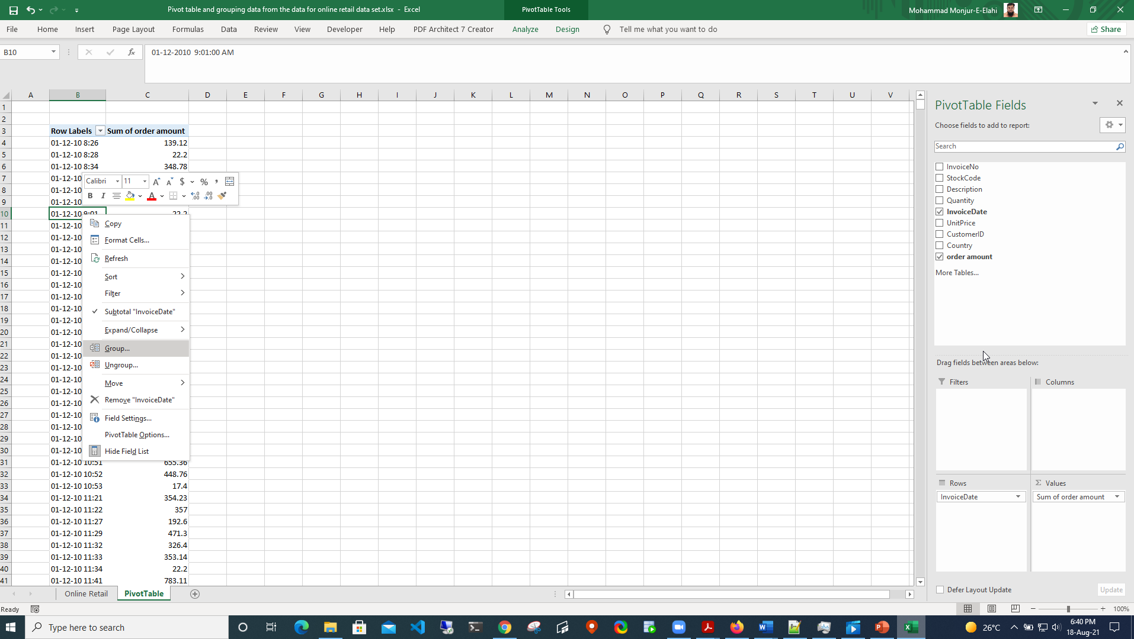

Slide 26


Slide 27


Slide 28
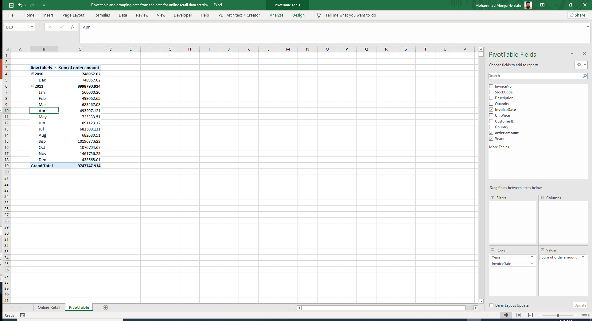

Slide 29
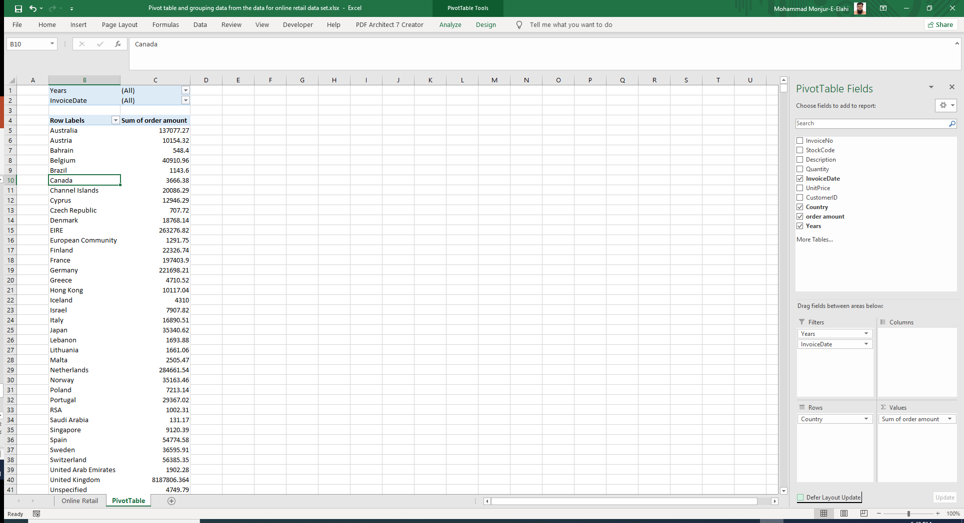

Slide 30
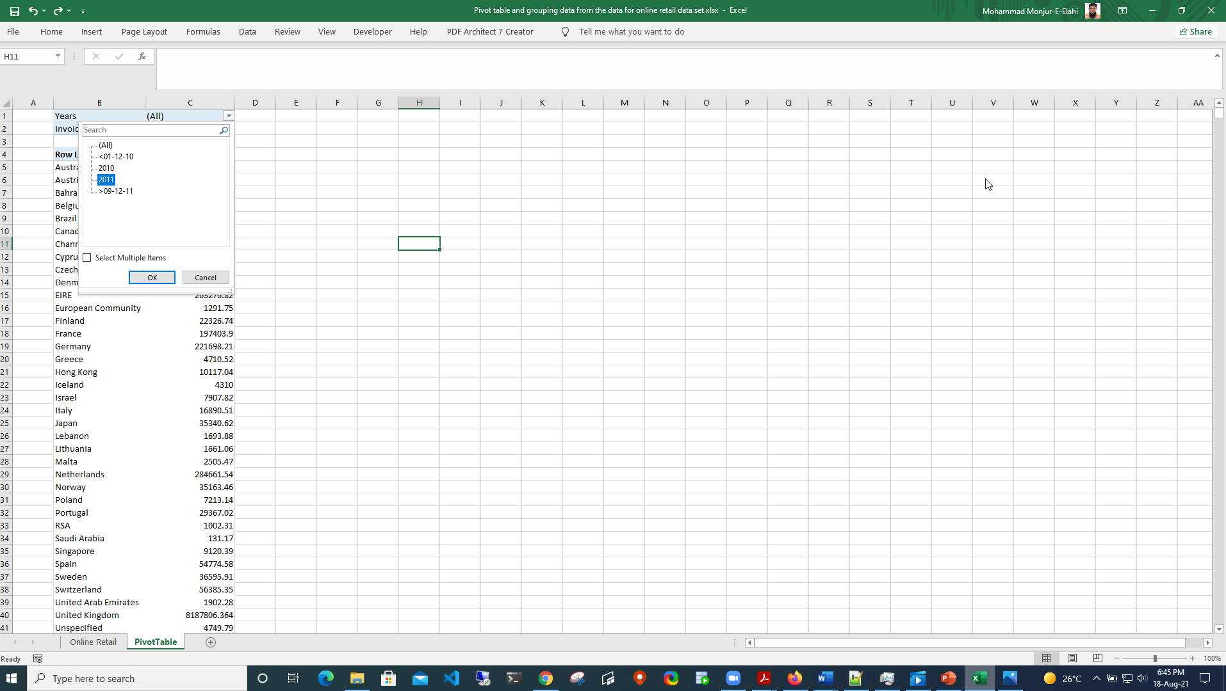

Slide 31
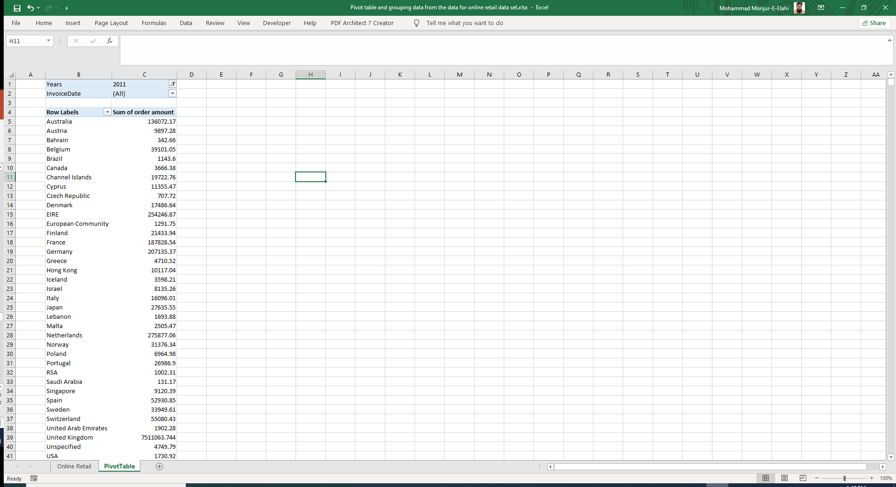

Slide 32


Slide 33
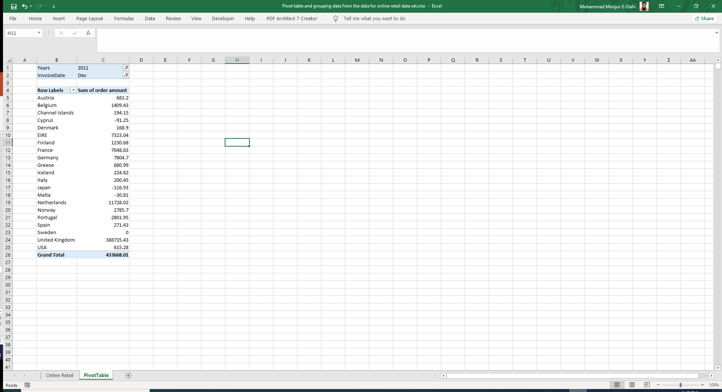

Slide 34
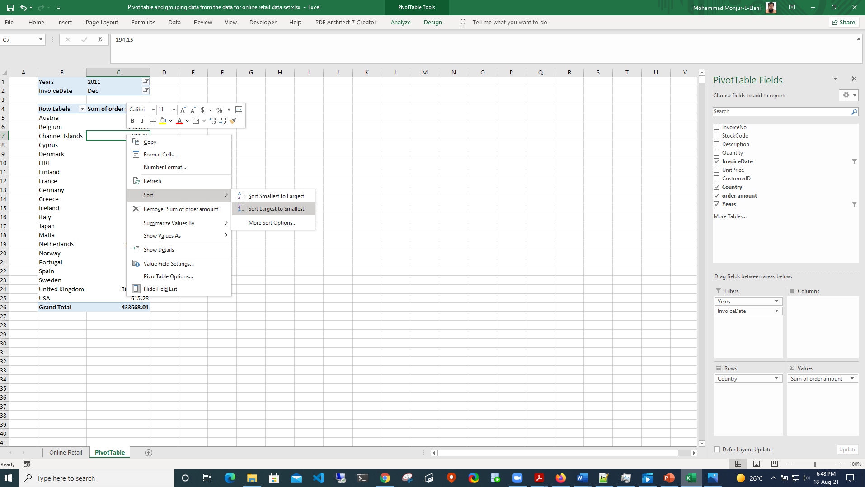

Slide 35
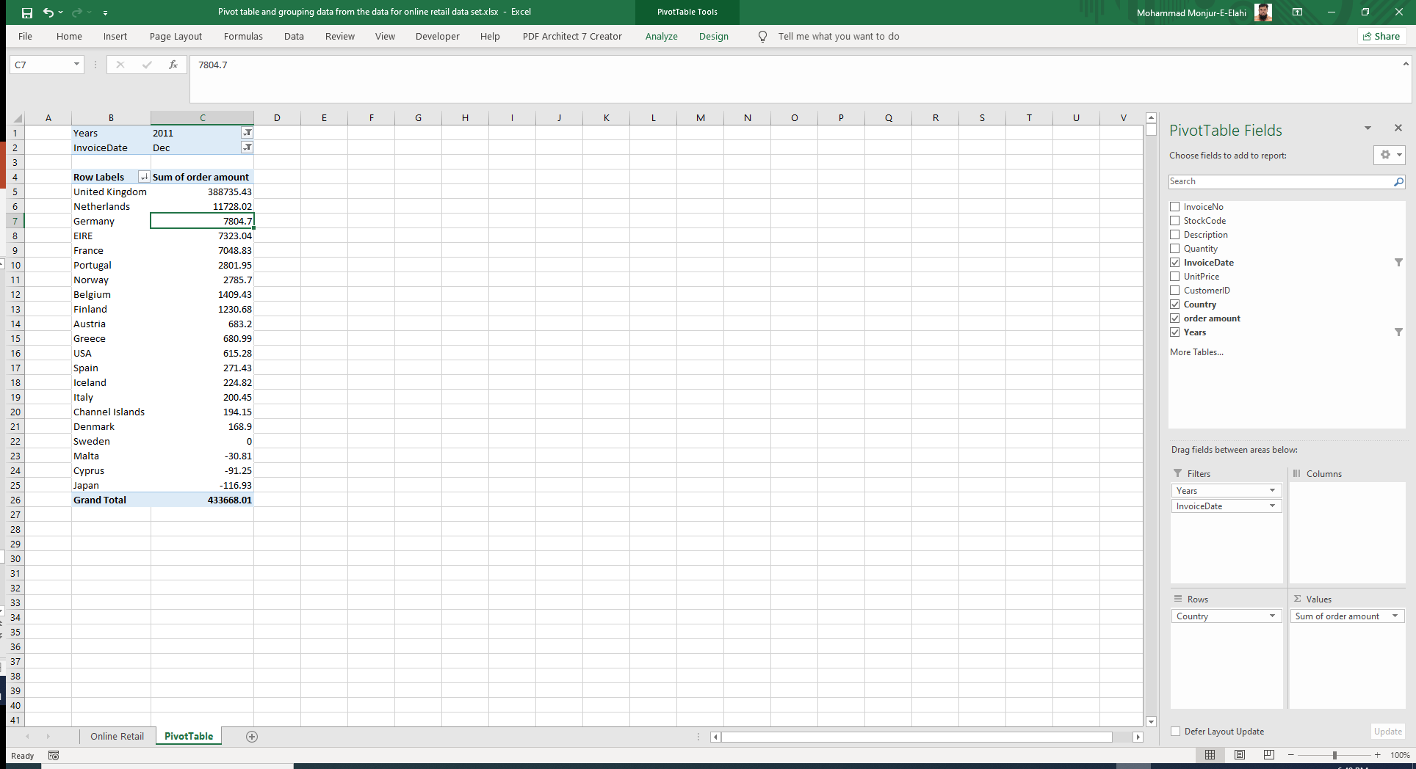

Slide 36


Slide 37


Slide 38
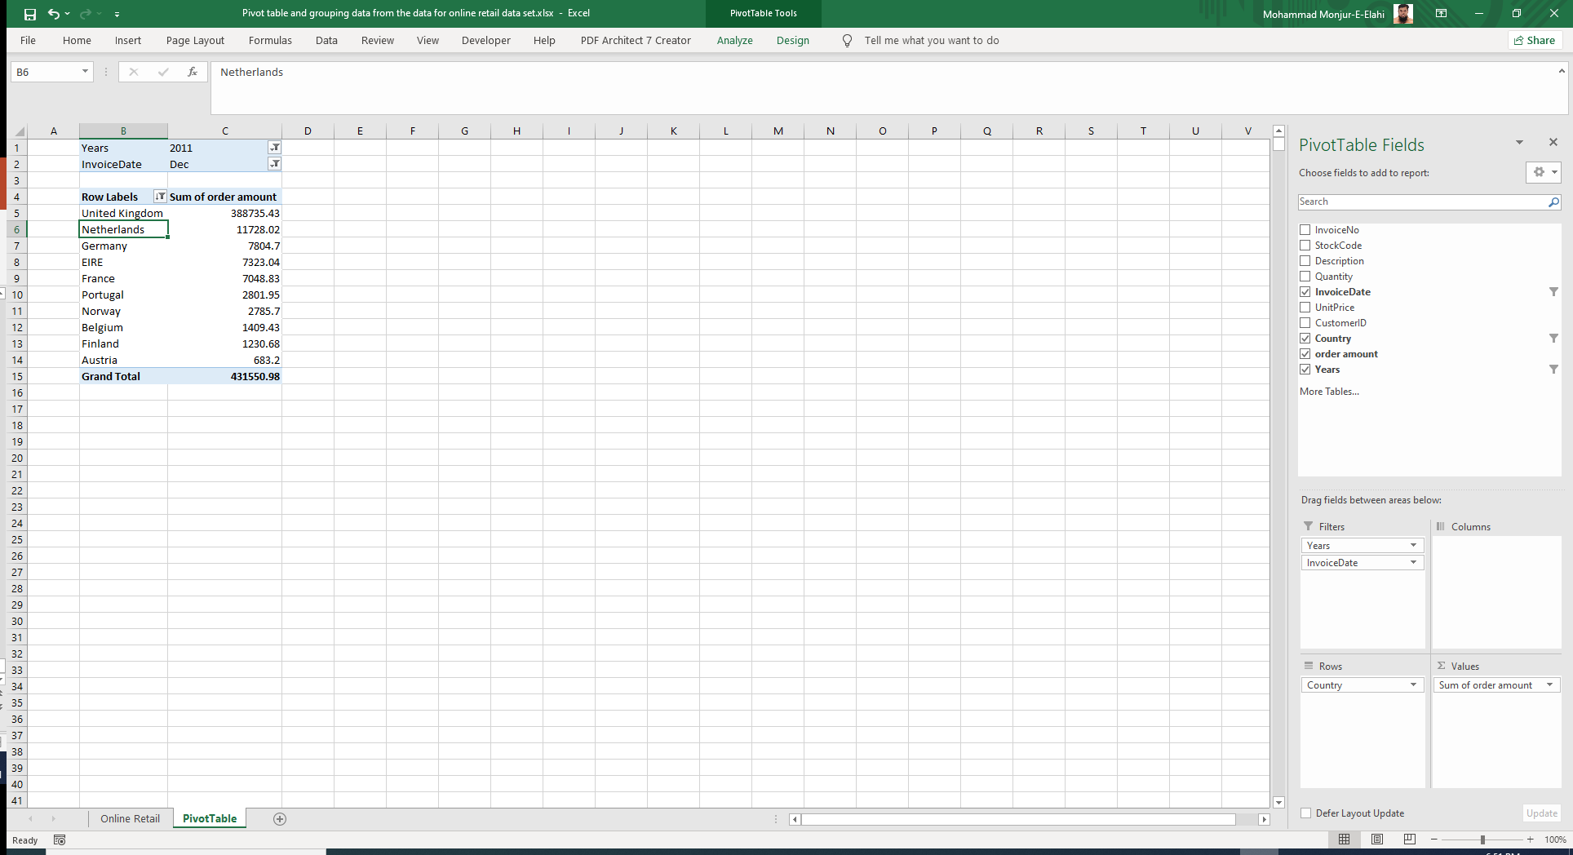

Slide 39
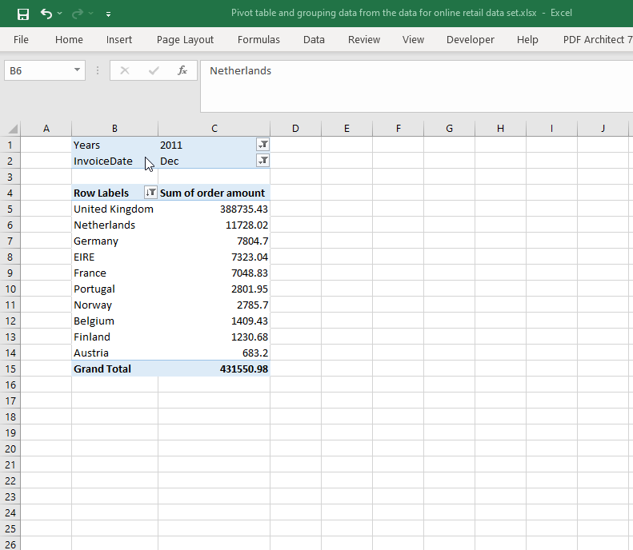
LIST

Slide 40
Creating a shape object or button and assign a macro to it that displays in message the current date
LIST

Slide 41
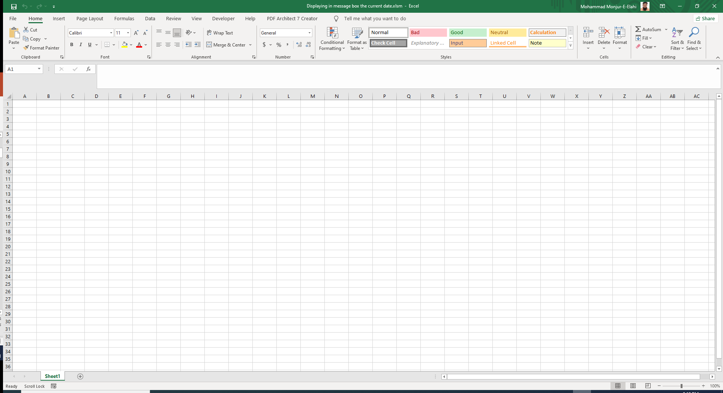

Slide 42
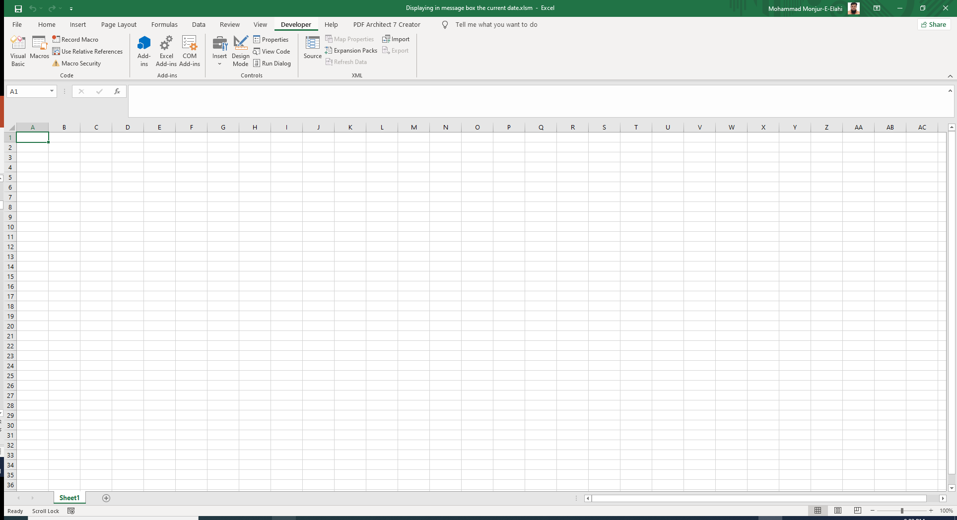

Slide 43
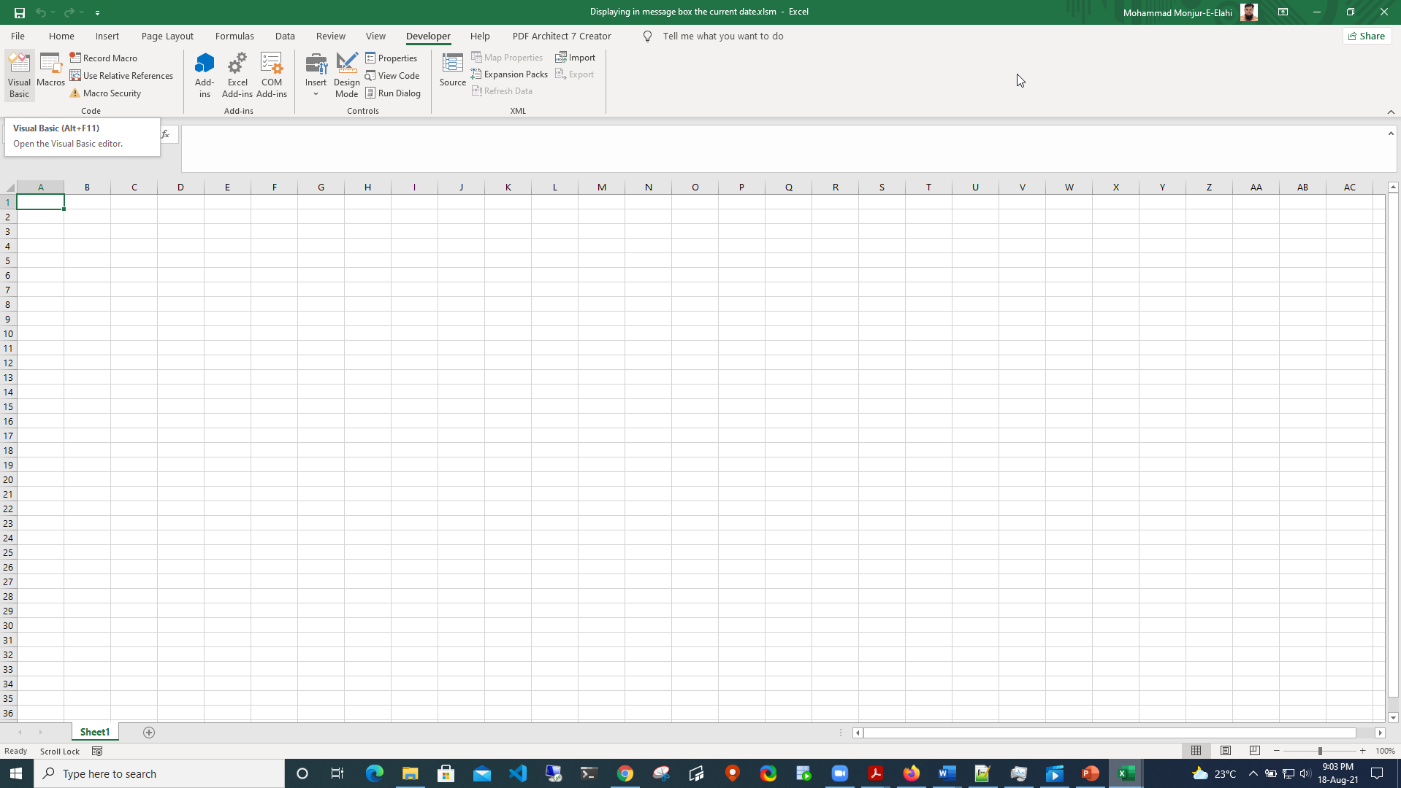

Slide 44
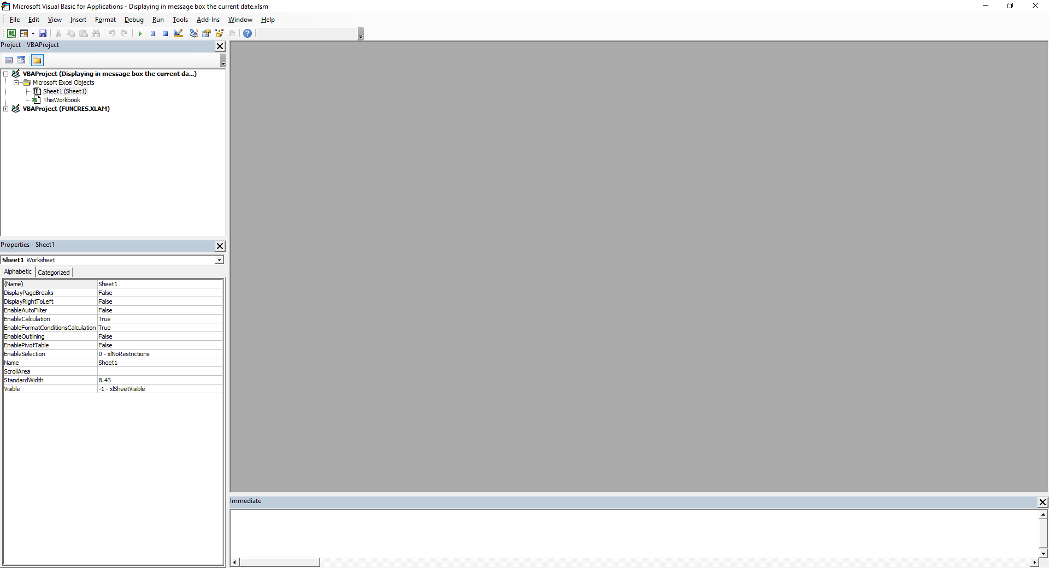

Slide 45
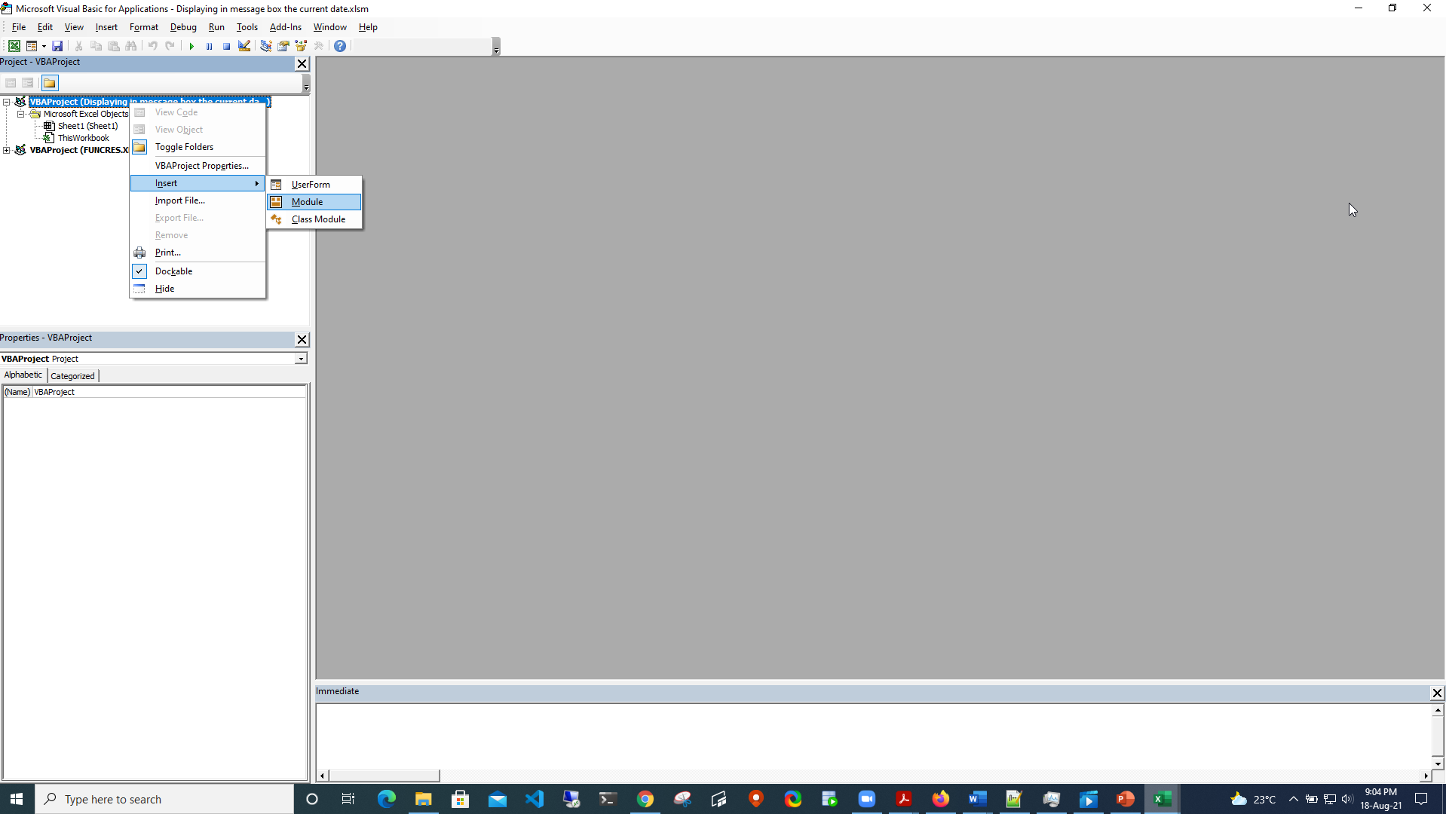

Slide 46
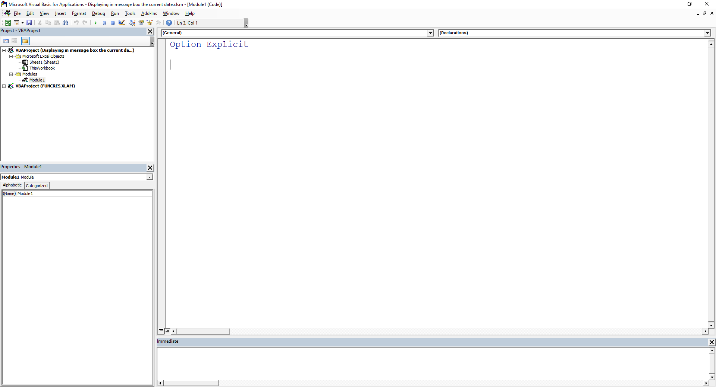

Slide 47
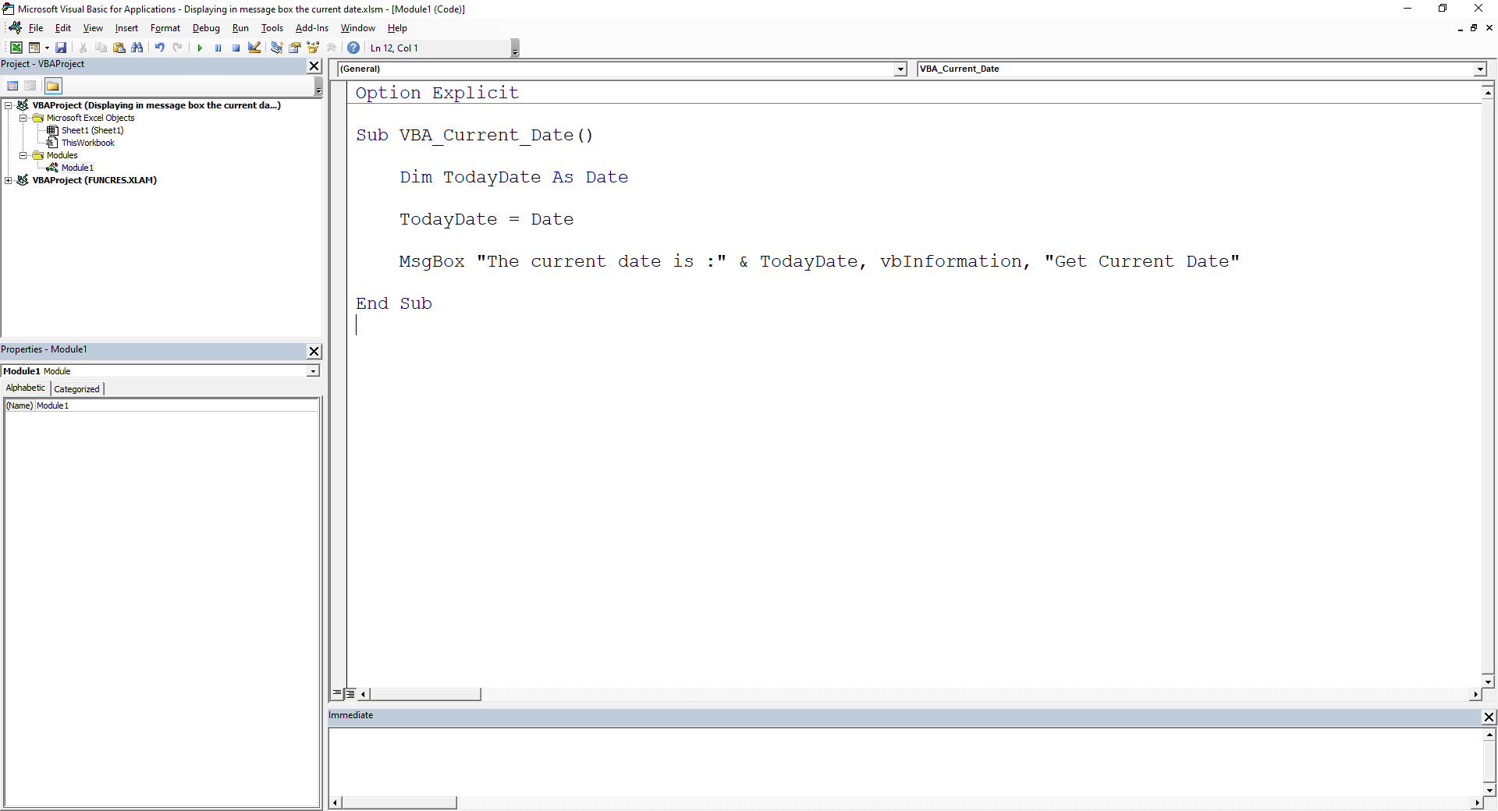

Slide 48
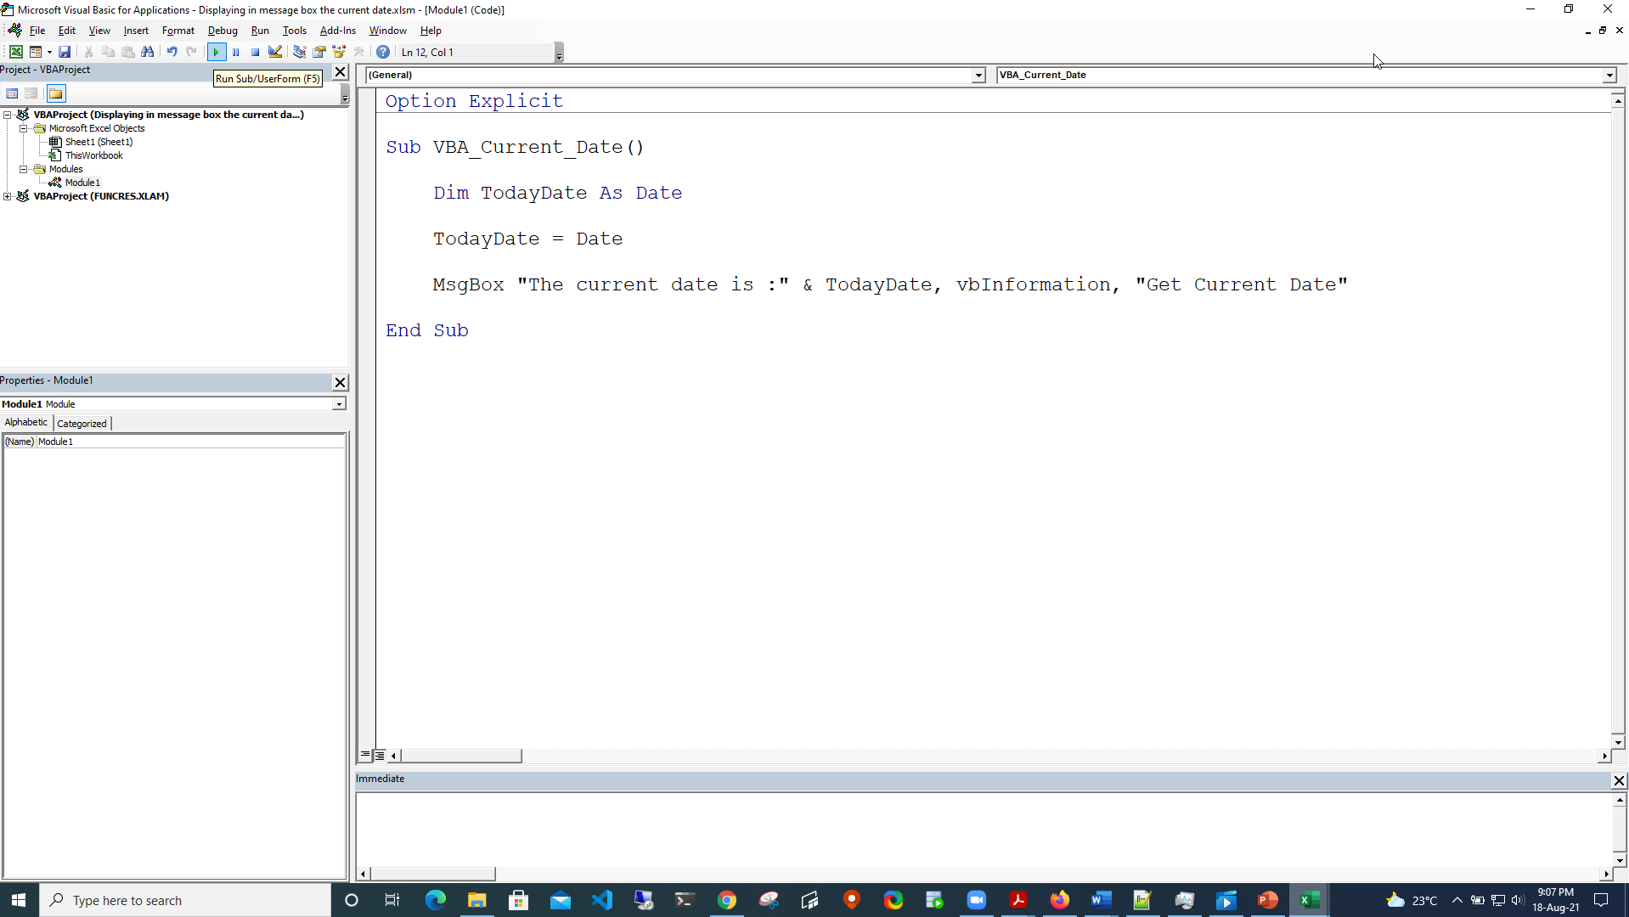

Slide 49


Slide 50
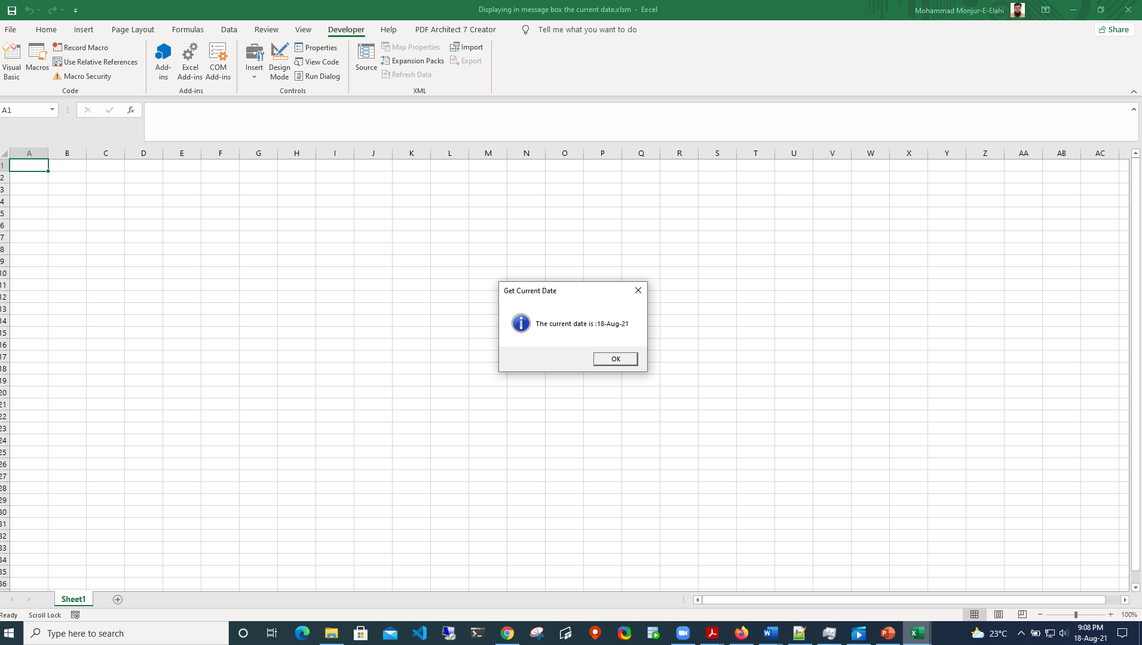

Slide 51
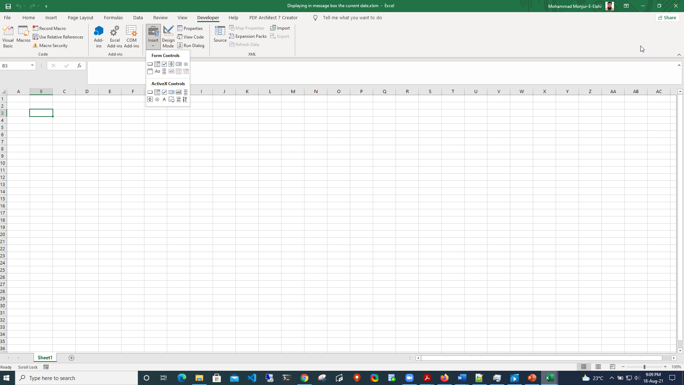

Slide 52


Slide 53
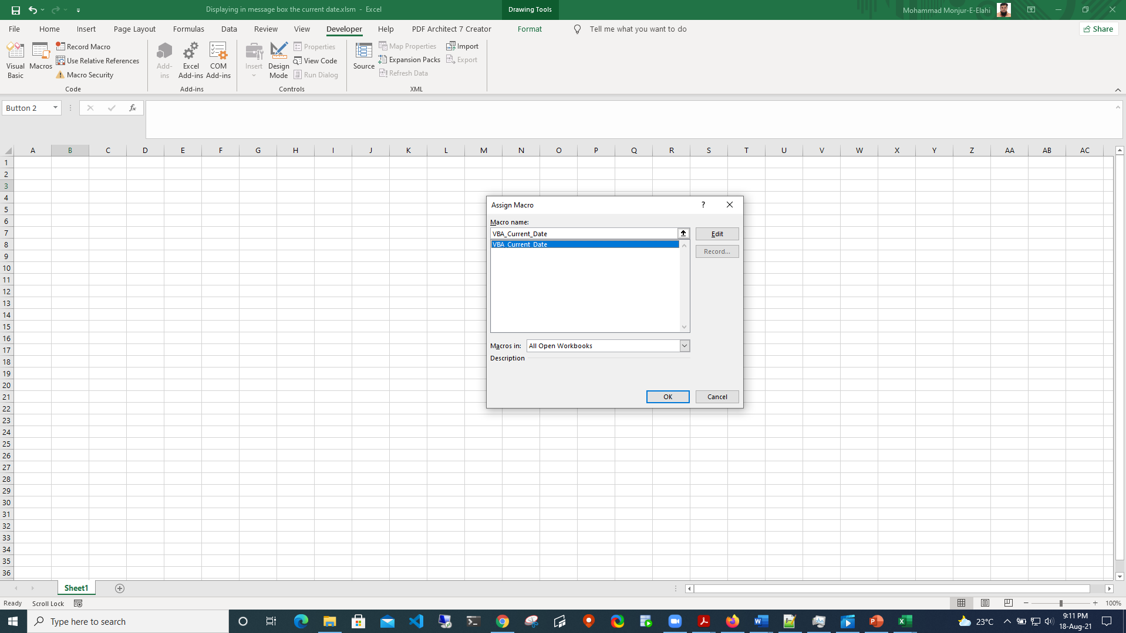

Slide 54
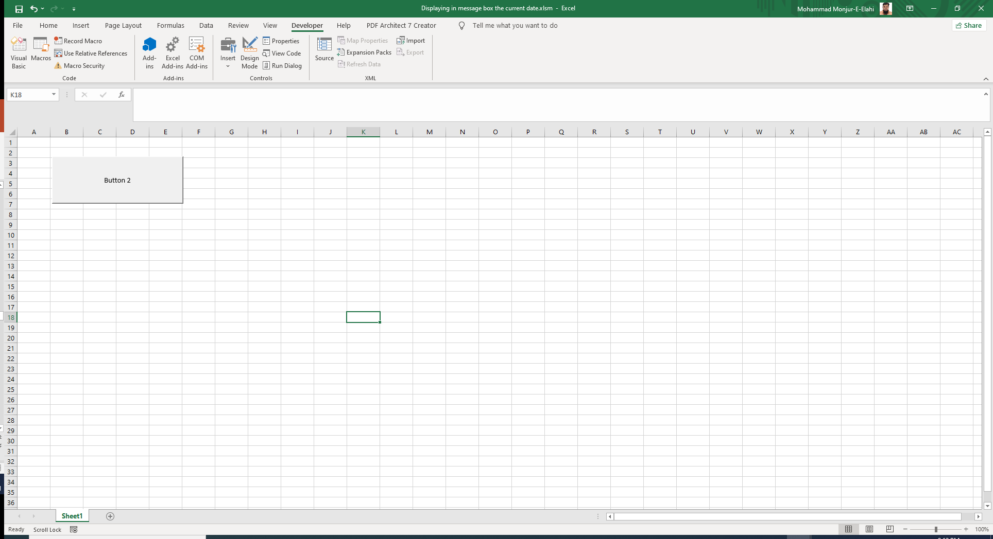

Slide 55
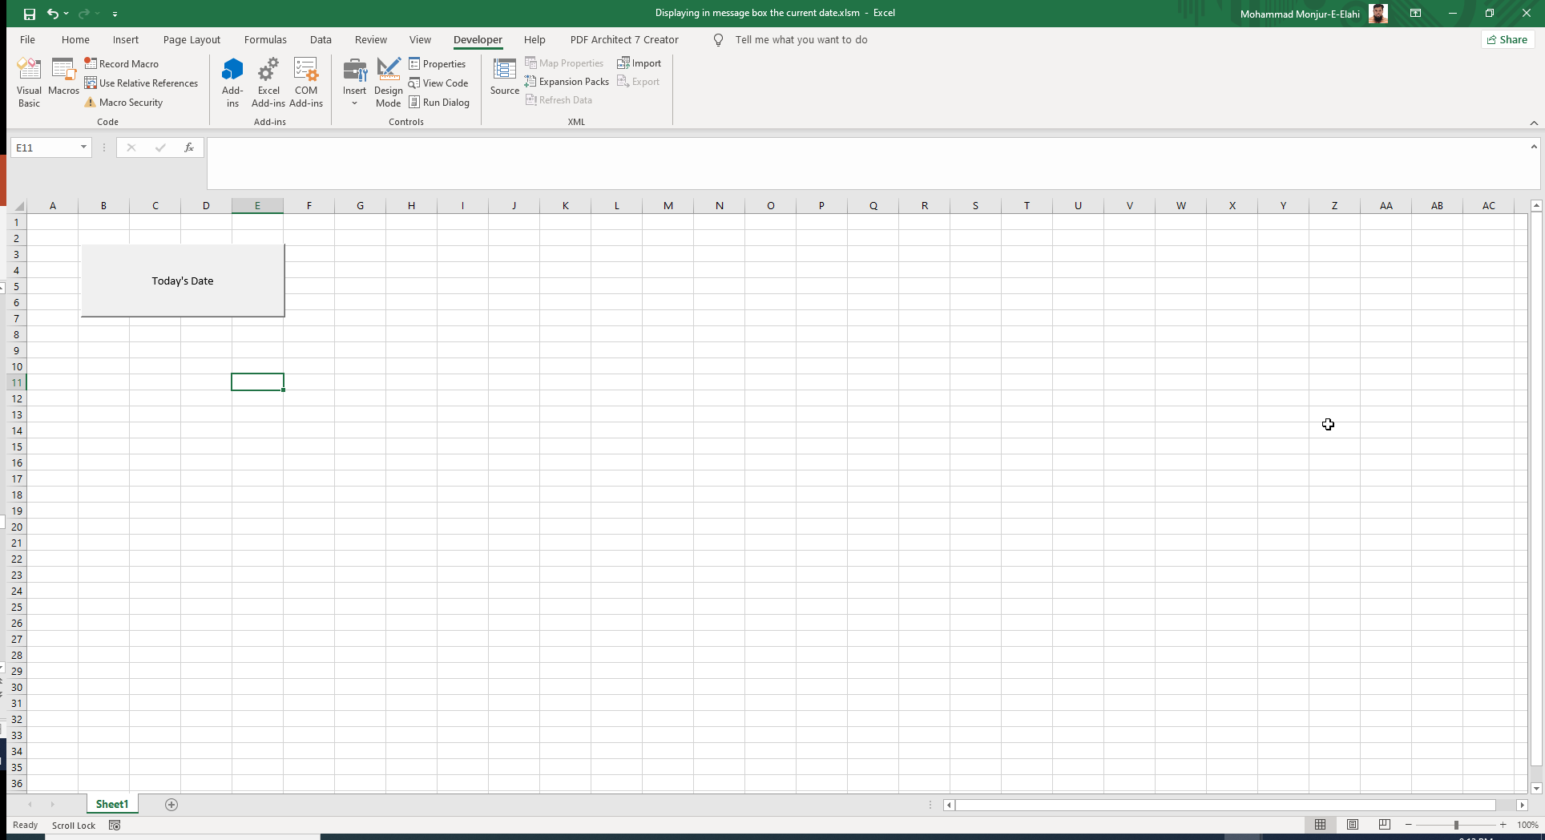

Slide 56
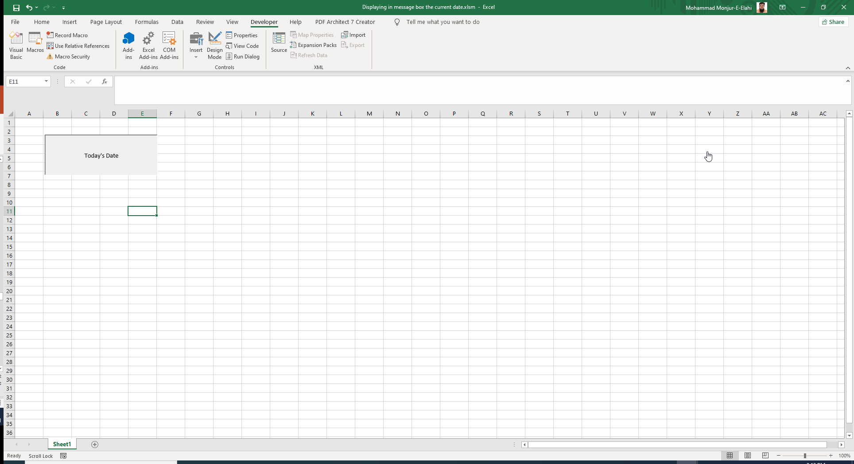

Slide 57

LIST

Slide 58
Creating a procedure that declares variables of type string and integer
LIST

Slide 59
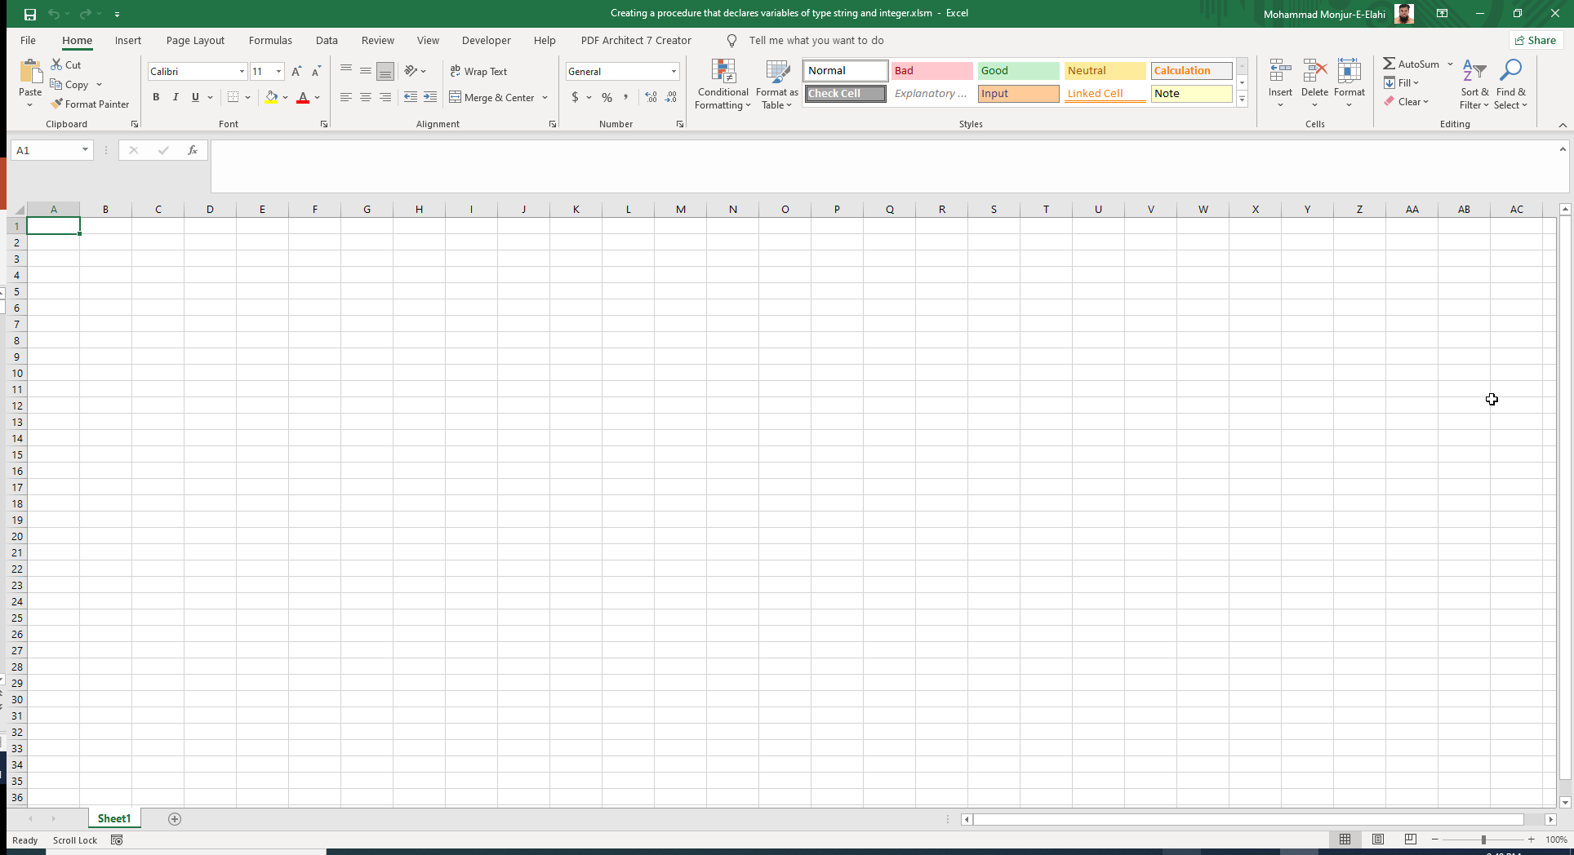

Slide 60
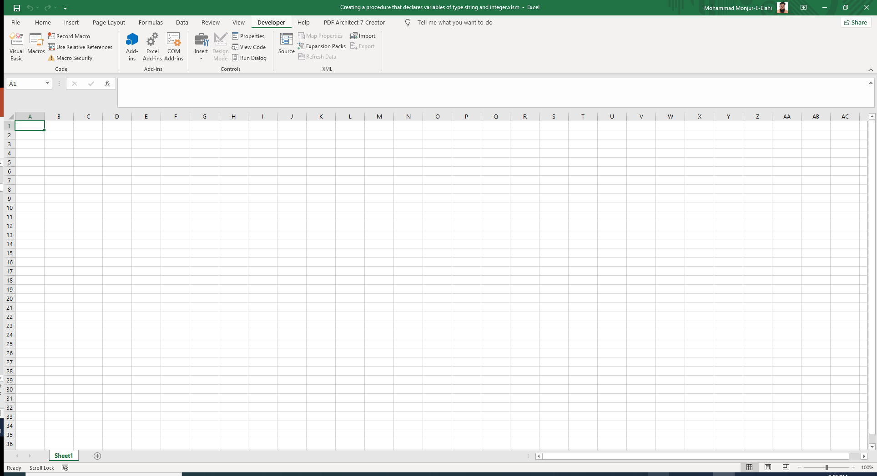

Slide 61


Slide 62


Slide 63
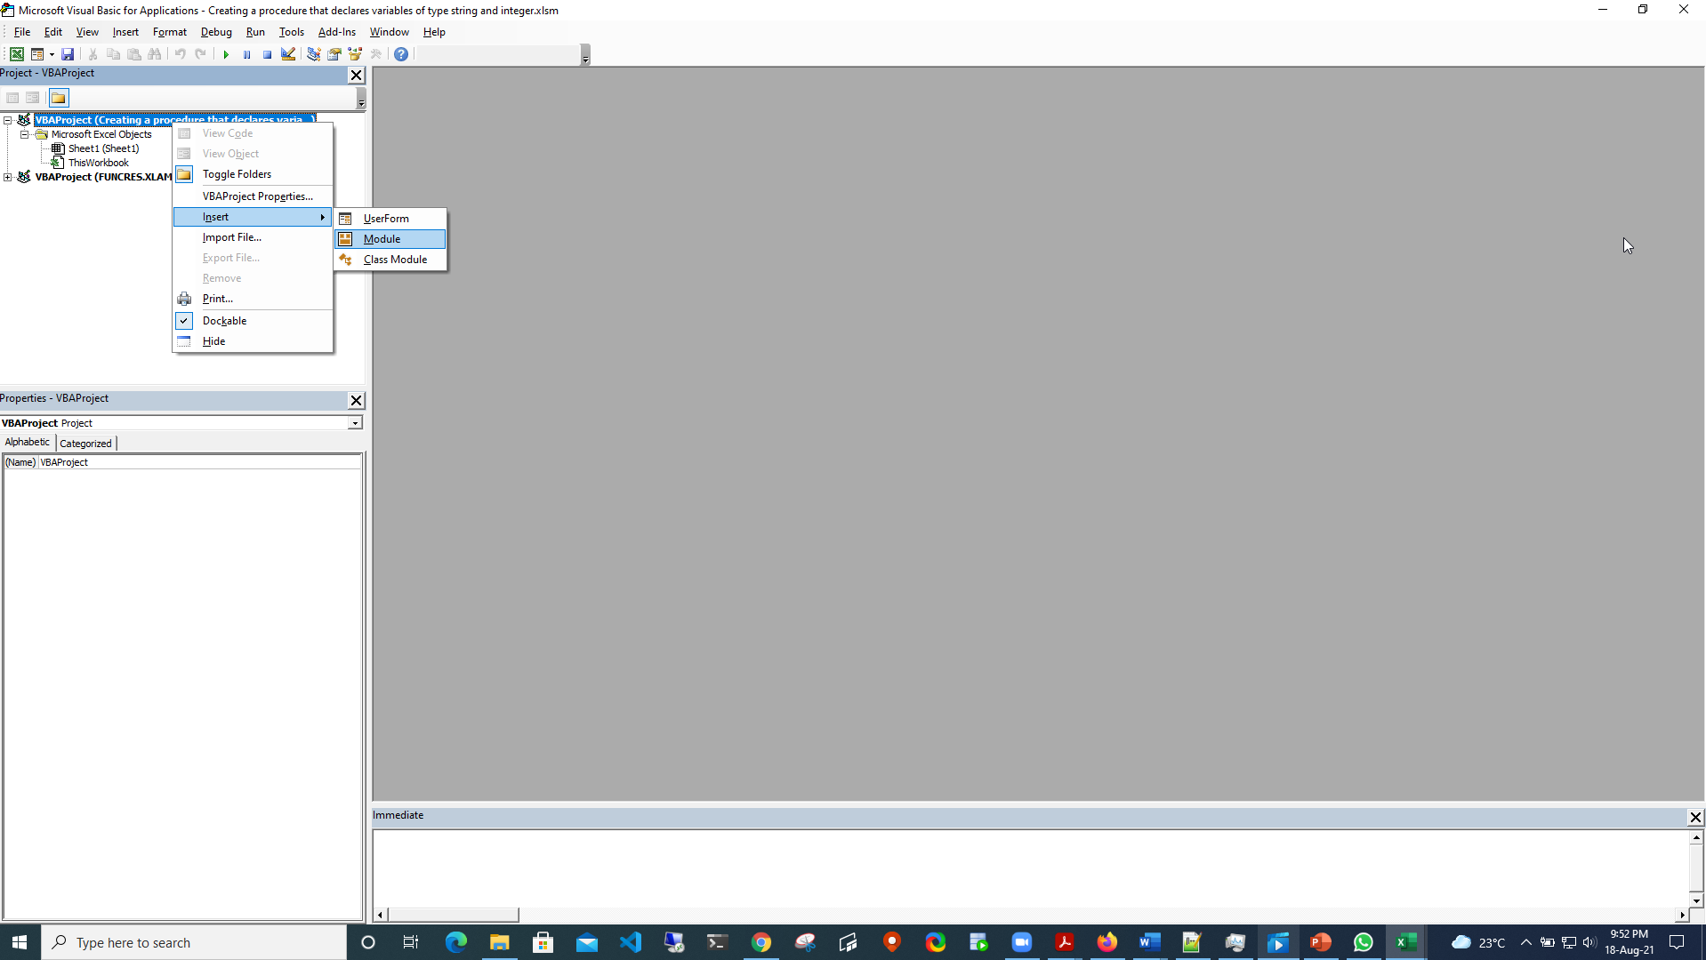

Slide 64
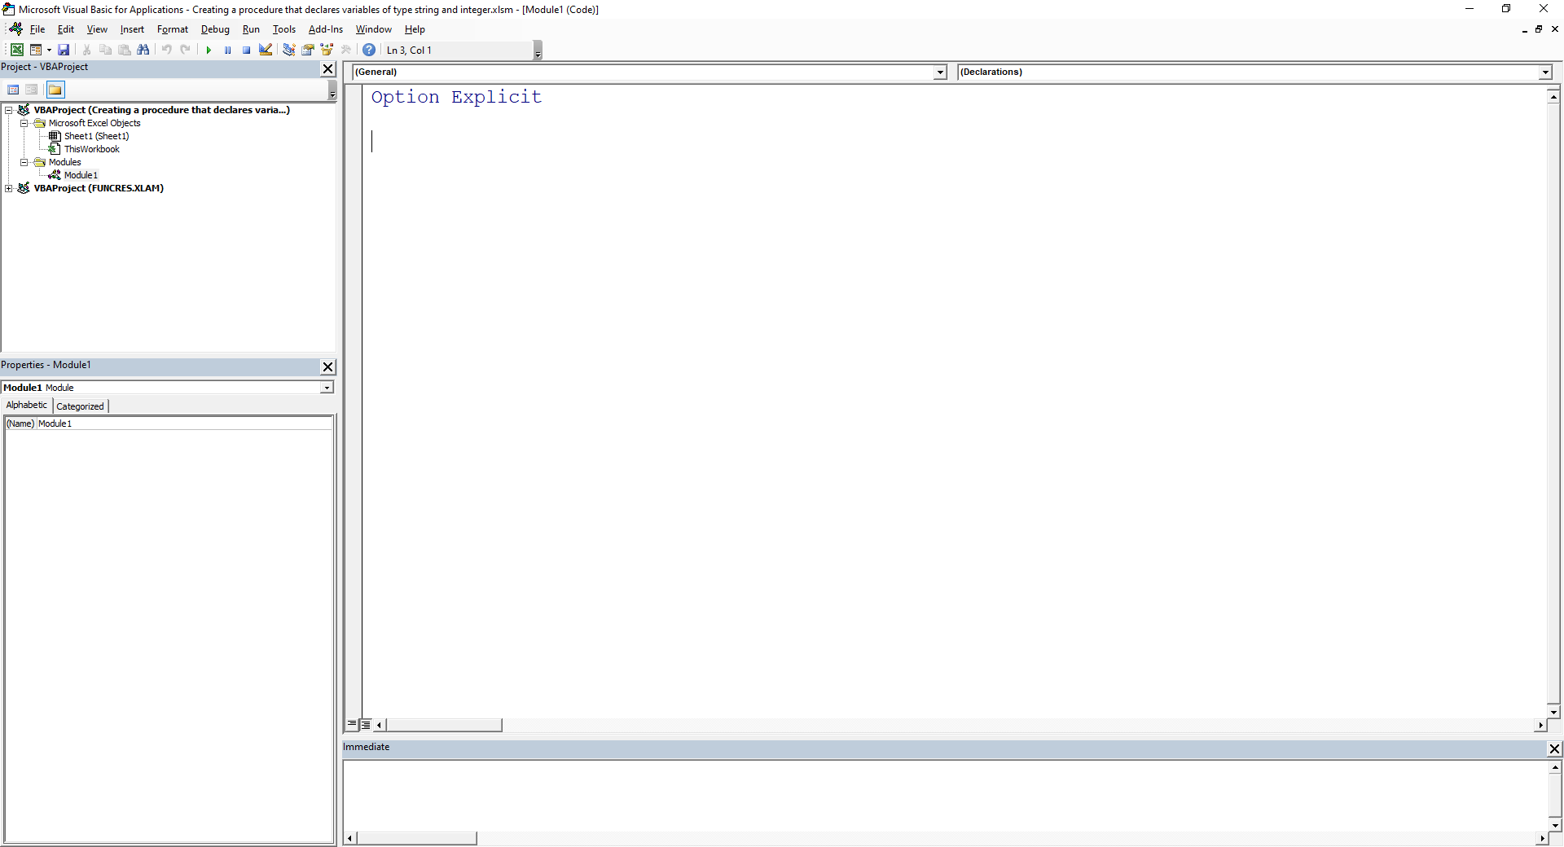

Slide 65
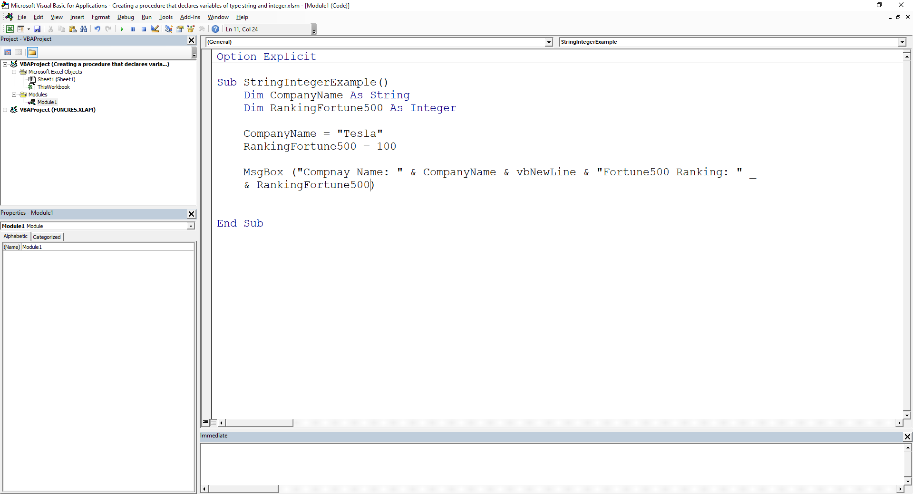
String and Integer declared

Slide 66
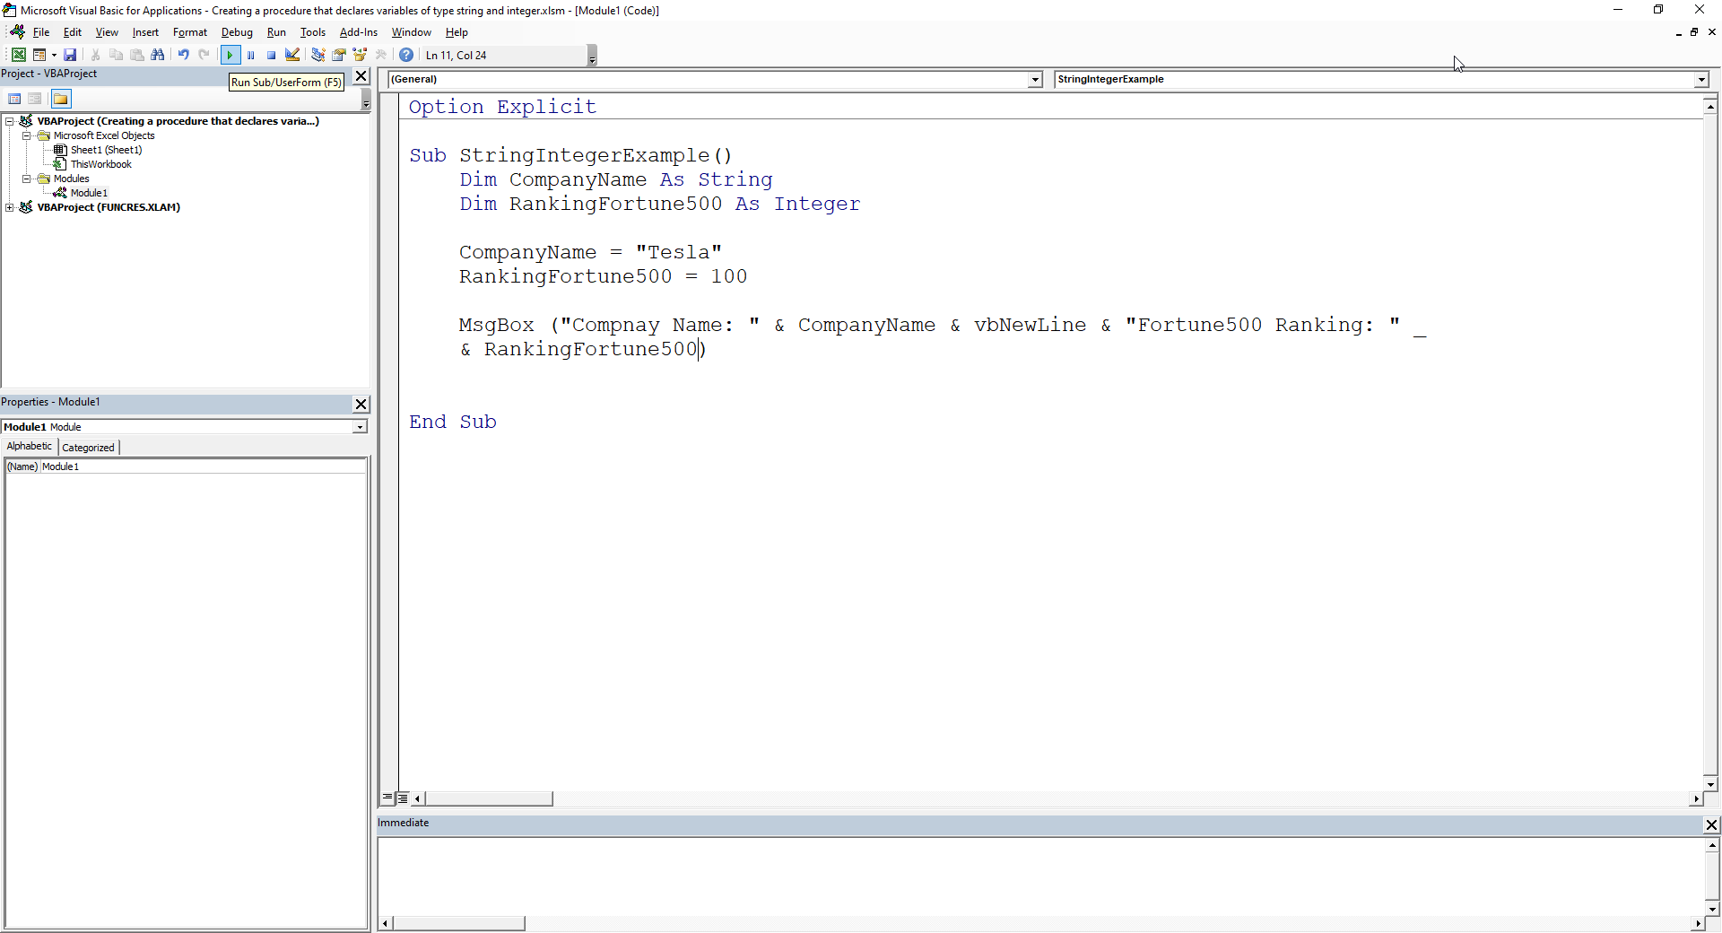

Slide 67


Slide 68
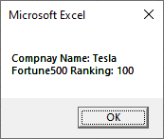

Slide 69

LIST

Slide 70
Creating a VBA procedure that changes the font color of table to bold
LIST

Slide 71

Took this table as existing one

Slide 72


Slide 73


Slide 74


Slide 75


Slide 76


Slide 77

Selected the whole table range

Slide 78

Before Running the code

Slide 79


Slide 80

Change as the code runs
LIST

Slide 81
Creating a VBA procedure that adds a yellow explanation column to right of table
LIST

Slide 82

Took this table as existing one

Slide 85


Slide 86


Slide 87

Got the code from macro recording and edited

Slide 88

Created the target column for color change

Slide 90

Change as the code runs
LIST

Slide 91
Creating a VBA procedure that uses loop
LIST

Slide 92


Slide 93


Slide 94


Slide 95


Slide 96


Slide 97

Before Running the code

Slide 98


Slide 99


Slide 100


Slide 101

Change as the code runs

Slide 102


Slide 103

LIST

Slide 104
Create a message box that displays number of executions of one procedure
LIST

Slide 107


Slide 108


Slide 109

Static causes the Counter value to persist

Slide 110


Slide 111


Slide 112


Slide 113


Slide 114

Increases until we discontinue

Slide 115

Increases until we discontinue

Slide 116


Slide 117


Slide 118


Slide 119

LIST

Slide 120
Creating a user Form that has two text boxes and a button to calculate sum and show it in a message box
LIST

Slide 121


Slide 123


Slide 124


Slide 125


Slide 126


Controls added

Slide 127

Changed color

Slide 128

Module inserted for the macro

Slide 129


Slide 130


Slide 131

Code for showing the form

Slide 132


Slide 133

Form is displayed but codes not added for addition yet

Slide 134


Slide 135

Linking the button to the macro of the form

Slide 136



Slide 137


Slide 138


Slide 139

Subprocesses added by double clicking the text boxes or command buttons
Code to initialize the numbers as zero

Slide 140


Slide 141


Slide 142


Slide 143


Testing for addition

Slide 144


Testing for clearing fields

Slide 145


Slide 146

LIST

Slide 147
Creating a User Form in Excel VBA to get name, date of birth , gender, telephone number, email , and postal code from the user and store the value provided by the user in the worksheet
LIST

Slide 150


Slide 151


Slide 152

Controls added, shaped and positioned

Slide 153

Module inserted for the macro

Slide 154

Code for showing the form

Slide 155


Slide 156


Slide 157


Slide 158

Form is displayed but codes not added for data insertion yet

Slide 159


Slide 160

All fields will be initialized as null apart from the Gender

Slide 161

All fields will be initialized as null apart from the Gender

Slide 162


Slide 163

Subprocesses added by double clicking on the text boxes and command buttons
Checking for blank fields

Slide 164

Searching for first blank row
Values from textboxes and Combo Boxes transferred to the appropriate columns

Slide 165


Slide 166


Slide 167


Slide 168

Checking for data insertion

Slide 169

Checking for clearing of fields

Slide 170

Checking for clearing of fields

Slide 171

Checking for quitting the form

Slide 172

LIST

Slide 173
Conclusion
For the User Forms the Tab Index had to be adjusted so that tab could be used effectively
Used macro recording for one or two tasks to get the code to edit and use for our purpose
The learning experience was absorbing and fun.
LIST

Slide 174
Thanks
Questions ?
LIST

